Slide 1
Enhancing your Advocacy with ACP Resources Kory Stuer Associate, State Health Policy and Advocacy State Health Policy Webinar February 12, 2025

Slide 2
Resources Overview
For All ACP Members
New Home for the Advocates for Internal Medicine (AIM) Network
State Health Policy Toolkits
Advocacy Assistance Request Form
For Chapter Leaders Only
State Health Policy Consultations
Grassroots Collaboration with ACP National
State Legislative Tracking
State Fact Sheets

Slide 3
Advocacy Resources for All ACP Members

Slide 4
New Home for AIM Network & Current Alerts
Visit ACP's Legislative Action Center (LAC):

Slide 5
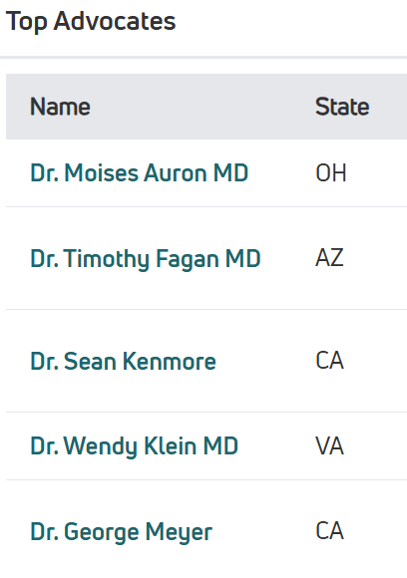
ACP Members' Grassroots Activity in 2024
Over 3,200 grassroots advocates took over 4,300 actions on ACP alerts
More than double the 2023 totals
Alerts with highest activity
Stop Medicare Physician Pay Cuts
Oppose the EDUCATE Act
August Recess Campaign

Slide 6
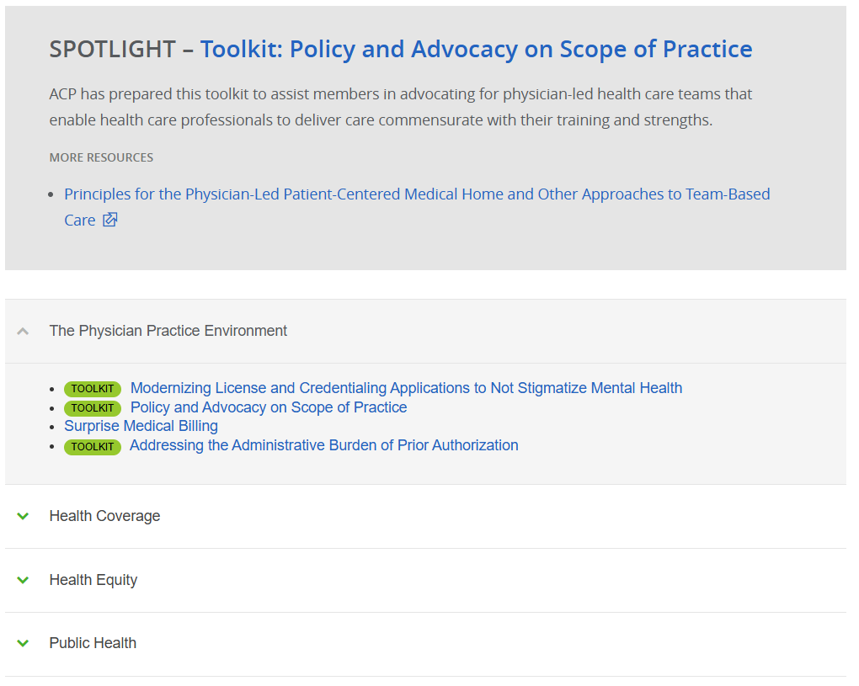
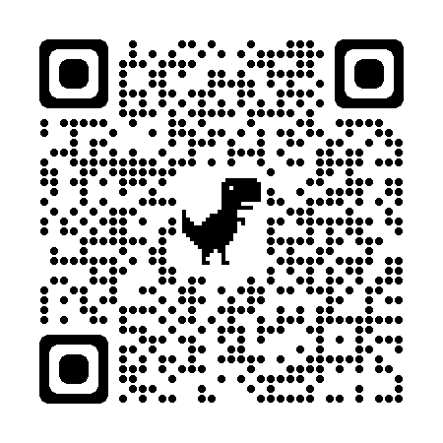
For all members – State Health Policy Toolkits
Available on ACPOnline Advocacy Page – State Health Policy
12 toolkits currently posted on variety of policy issues
See toolkits on ACPOnline

Slide 7
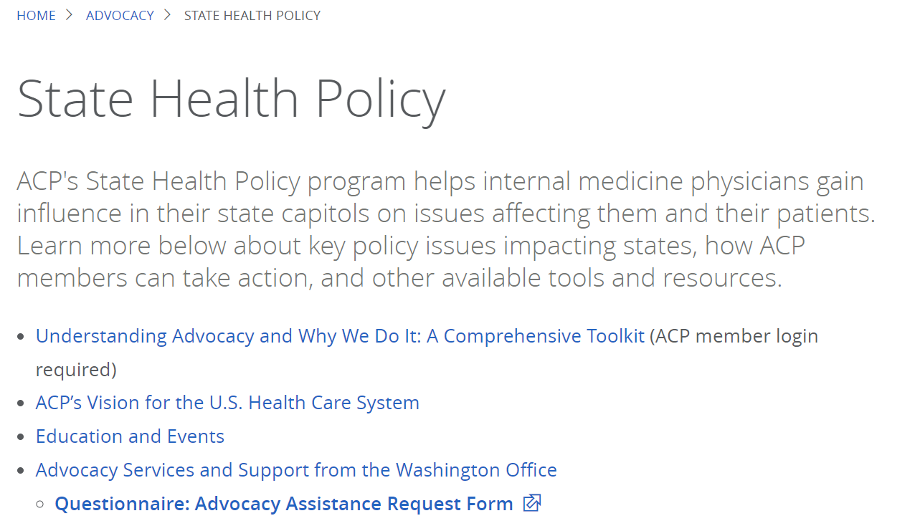
For all members – Advocacy Assistance Request Form
ACP State Health Policy Staff
Available on State Health Policy page on ACPOnline
Access the form on ACPOnline:

Slide 8
Advocacy Resources for Chapter Leaders

Slide 9
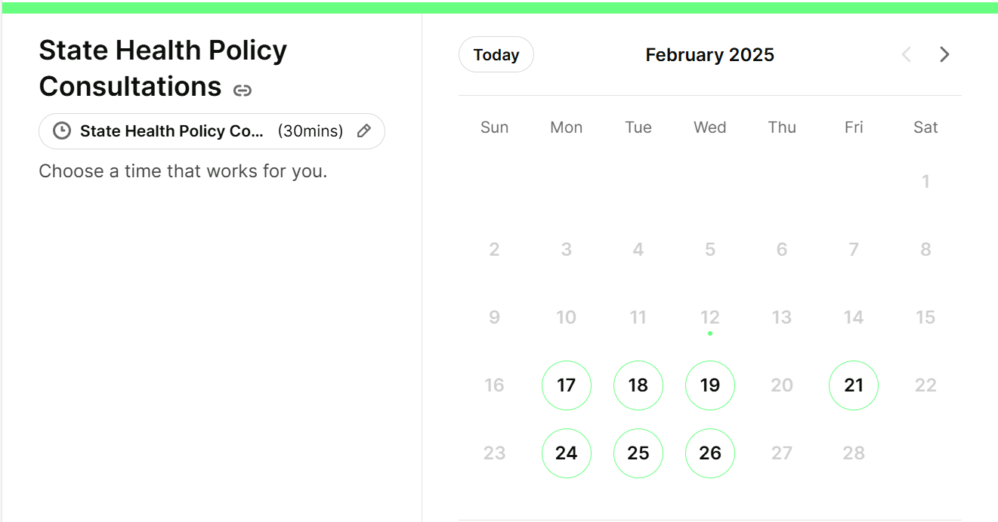
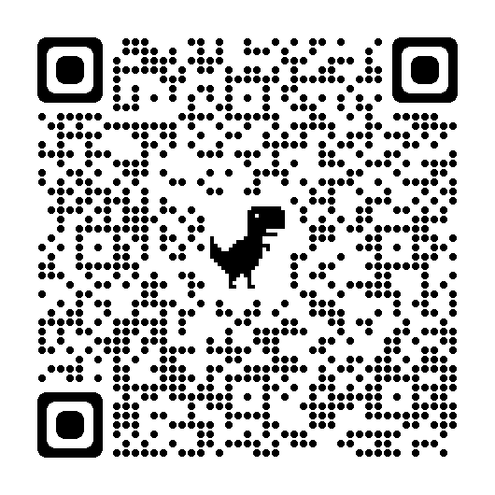
For Chapter Leaders – Consultations with State Health Policy Staff
ACP National's state health policy team is available to be booked for consultations to discuss policy issues in your state, advocacy strategies, and more
More information on LeaderNet:

Slide 10
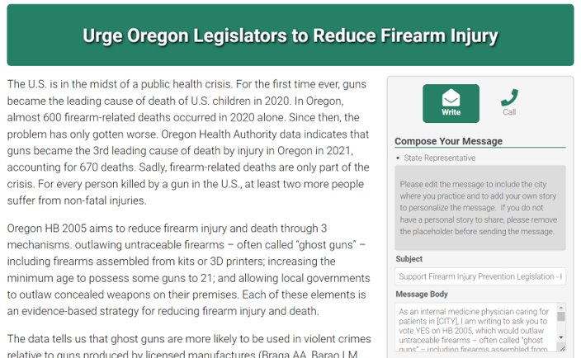
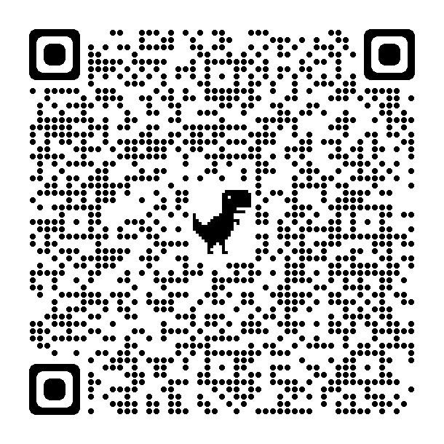
For Chapter Leaders – Grassroots Collaboration with ACP National
Chapter leaders can now request to use ACP's grassroots software to facilitate their members contacting elected officials about health policy issues in their state
More information on LeaderNet:

Slide 11
For Chapter Leaders – State Legislative Tracking
State Leg Tracking on LeaderNet:
ACP is tracking state legislation on:
Reproductive health
Scope of Practice
Firearm Injury Prevention
Prior Authorization

Slide 12
For Chapter Leaders – State Fact Sheets
Now available for 50 states + DC
Featuring key data points that can be used in your advocacy
Accompanying guidance document with additional information also posted on LeaderNet
State Fact Sheets on LeaderNet:

