Slide 1
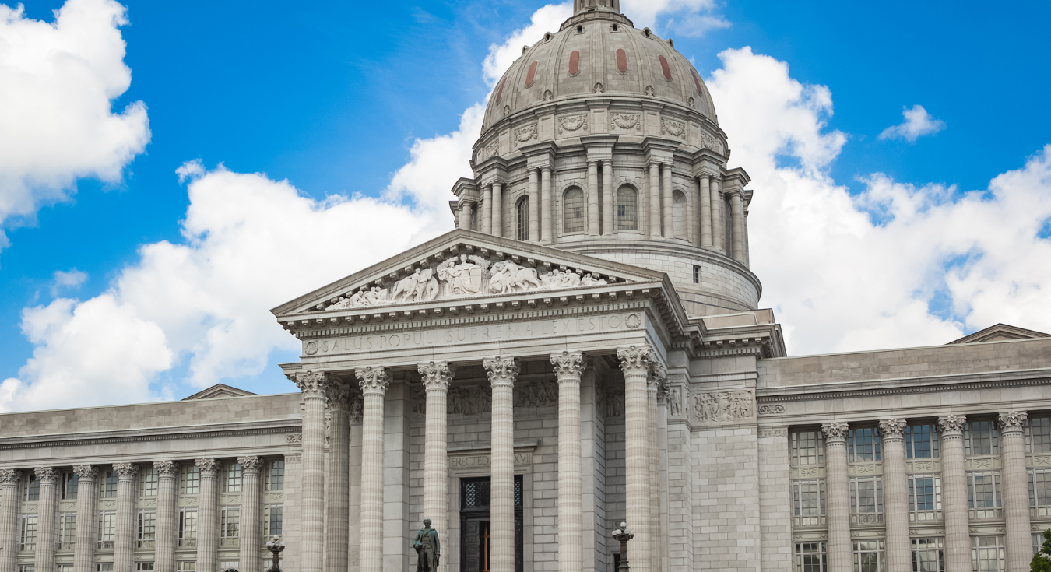
Hosting a State Advocacy Day
Jacqueline Fairchild, MD, FACP, Governor, Missouri Chapter

Slide 2
Planning
We received an email from SLU's residency program stating they would like to send their residents to Advocacy Day in 2024, but need to know the date very soon as they will need to close the clinic. I think it would be great for us to move forward on selecting a date now instead of this fall.
I talked with the MOCEP lobbyist and she thinks we should try for a Wednesday for our 2024 date as this may lead to better meetings with the legislators. There is no guarantee, but she said leadership would be the same next year as this year and they would likely keep a similar schedule, so Wednesday would be better. I think we should keep it as the last Wednesday in February, which would be Feb. 28. Are you okay with us selecting a date now, and will that date work?
Thanks,
Having proactive, knowledgeable chair/co-chair is VERY helpful.
Have your Executive Director help you!
Consider the legislative schedule when selecting the date, check for significant legislative deadlines or events that could impact attendance.
Choose a date that allows for maximum participation.
Logistics – select a venue and gather materials (AV, refreshments, etc.) Consider the weather and time of year (usually winter…)
Notes:
Plan EARLY so that residency programs, medical schools and working colleagues can arrange their schedule. Try and anticipate what the legislators are doing.
Use a carrot to try get people interested.
Engage your HPPC and decide on your issues
Send out invite for people to put on their calanders

Slide 3
Collaborating
Don’t forget your own HPPC – they should be the ones leading the charge!
Join forces with others! Work with other specialties or the state medical association to enhance reach and influence.
Strength in numbers elevates your voice and message!
Wear white coats to make a big visual impact.
Notes:
Partnering with local chapters that may have similar issues. Eg we partner with MOCEP (MO College Emergency Physicians) not only to have increased numbers but to also use their resources. MOCPE does have a _lobbyist_ and she gave us an amazing presentation of behind the scenes and more insight into bills that are worth looking into that may already have traction. Also, some insight into the state representatives and how they “lean”. We also collaborated with MSMA and attended a webinar where they discussed bills that were on the floor that were important to them. MSMA also has a legislative report that is very helpful if you have members that are also part of MSMA and can have that insight. Use ACP advocacy toolkits

Slide 4
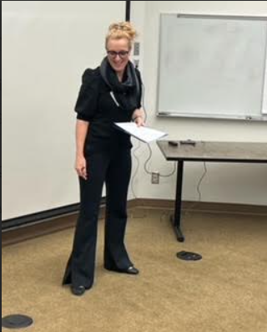
Setting Up the Day
Host an Issue Review Session:
Brief participants on key issues to be discussed.
Utilize data and personal stories to highlight the importance of issues.
Invite legislators to speak
Reach out to legislators to address the group. Make sure to contact any physicians in office.
Give advocacy tips to help them convey the message.
Share effective communication strategies and personal anecdotes.
Emphasize being concise, clear, and passionate.
Notes:
Be organized
Speaking roles tomorrow
HPPC
Search for all messages with label HPPC
Remove label HPPC from this conversation
Missouri ACP <acpmissouri@gmail.com>
Tue, Feb 27, 8:18 AM
to me, Joanne, Ernie
The MOCEP lobbyist will be there tomorrow, and will talk about the session overall, and the bills they are working on (many overlap with ACP's priorities too). She likely will not mention the Gold Card Prior Auth issue because PA doesn't impact EDs (it does in the grand scheme of things with hospital admissions and boarding issues, but not directly). Would any of you be comfortable to talk about the Gold Card PA bill(s)?
Dr. Fairchild and Dr. Bausano (MOCEP President) will do the introductions tomorrow (I have prepared notes for this). Last year we had an ACP person talk about effective advocacy, so I have asked some MOCEP people to do it this year, so we can alternate. Feel free to add anything you feel they may miss as I don't prepare anything for this talk, I select a person who I know has experience with it and let them give their thoughts. Every person does it a little differently and I think this prevents it from getting too dry for those who come year after year.
I look forward to seeing you all tomorrow!
Have a script prepard.

Slide 5
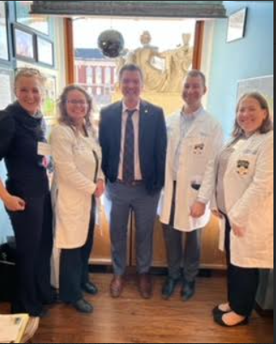
Create Teams
Creating Teams:
Organize participants into small teams to work together during visits.
Mix experienced advocates with first timers to guide and support.
Encouraging Inclusion:
Provide roles for residents/students to help build their confidence.
Empower every voice to feel valued within their teams.

Slide 6
To schedule or not to schedule….
Pros of Scheduling Visits:
Ensures that participants meet with the appropriate legislators.
Helps to maximize time and prepare for discussions.
Cons of Scheduling Visits:
May limit spontaneous interactions that can foster connections.
Legislators may be busy or unavailable at scheduled times.
Best Practice:
Have a flexible approach - prioritize key meetings and allow for walk-ins where possible.

Slide 7
Handouts/Leave behinds
Creating Effective Handouts:
Summarize key issues, proposed legislation, and calls to action.
Visuals and Resources:
Use visuals like charts/graphs to illustrate key points.
Include contact information for follow-up.

Slide 8
Notes:
Have HPPC review these as often have good tips for improvement
Decide if you want to do color
Maybe have some fun swag
Take your business cards.

Slide 9
Questions?

