Slide 1
ACP Advocacy Efforts in the Wake of the 2024 Election State Health Policy Networking Webinar February 12, 2024
Shari M. Erickson, MPH Chief Advocacy Officer and Senior Vice President, Governmental Affairs and Public Policy

Slide 2
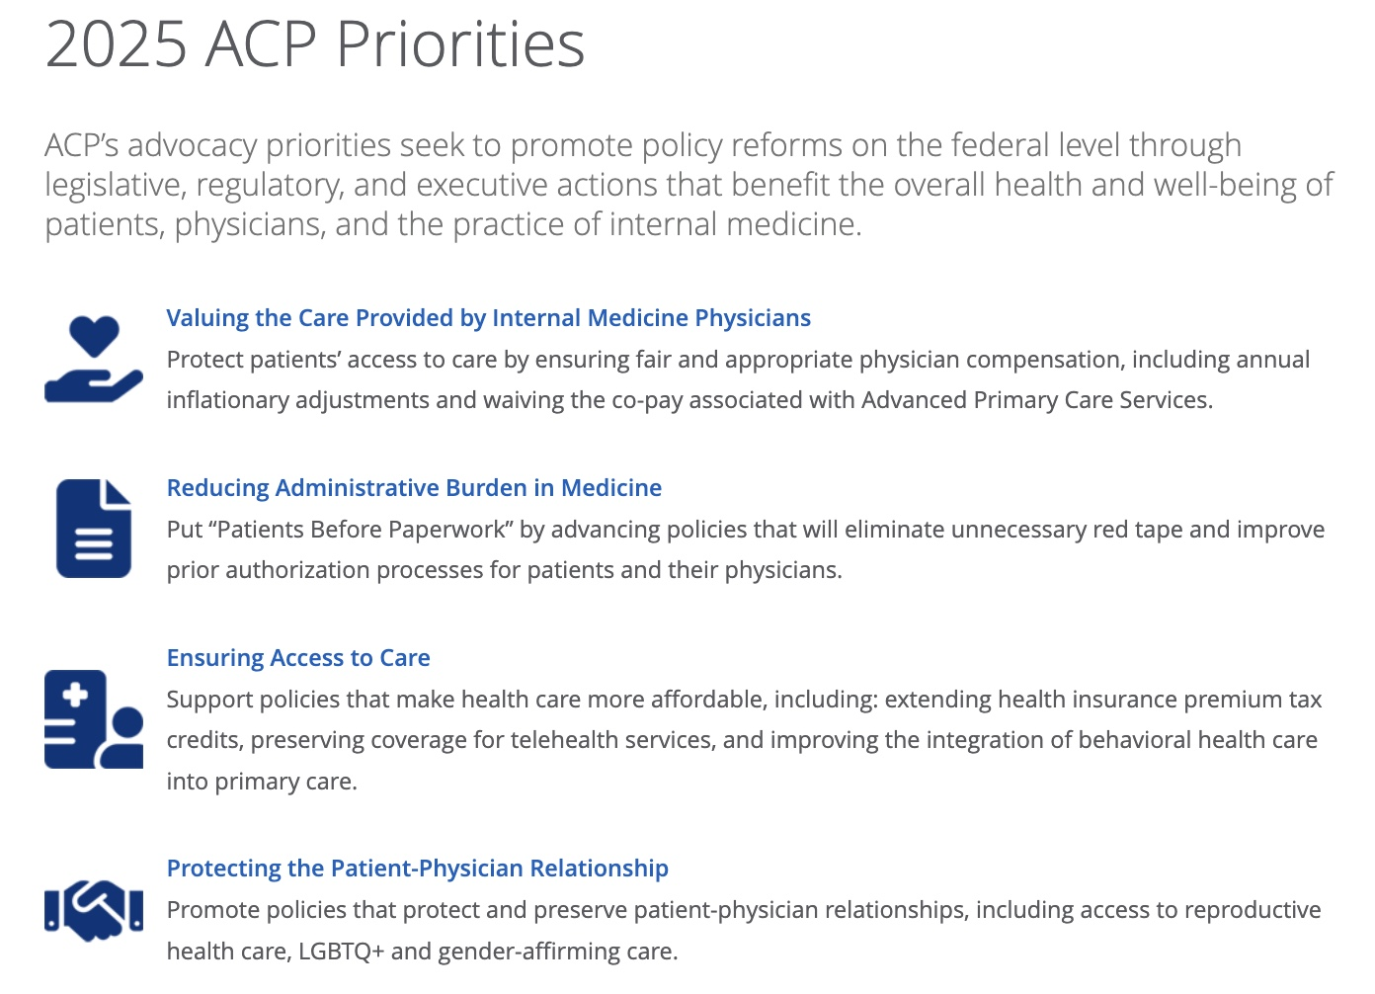
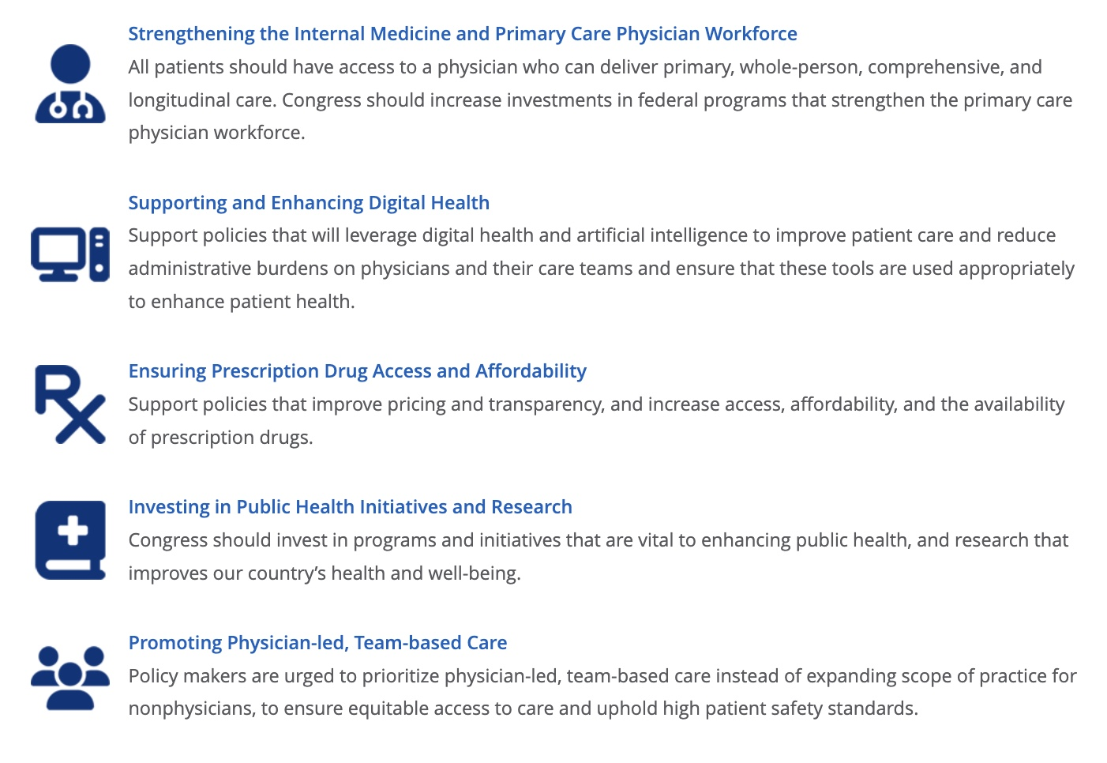

Slide 3
ACP’s 2025 Policy & Advocacy Priorities
Physician Payment
Administrative Burden
Access to Care
Patient-Physician Relationship
IM Workforce
Digital Health
Prescription Drug Access
Public Health (including immunizations)
Scope of Practice
https://www.acponline.org/advocacy/where-we-stand/2025-acp-priorities
Notes:
Thank you, Dr. Opole.
Dr. Opole covered a subset of these priorities, including workforce physician payment, administrative burden, access to care, and public health, when discussing the letter to the Trump Administration Transition Team, as well as in the Action Alert that you all can take now.
In addition to these priorities, ACP is also continuing its focus on protecting the patient-physician relationship. This includes promoting policies such as ensuring access to reproductive health care, LGBTQ+ and gender-affirming care. These issues, as well as ACP’s priority of promoting physician-led, team-based care instead of expanding scope of practice for nonphysicians, have a strong state-based focus—and ACP has been and will continue to build out our support for our state chapters to engage in advocacy.
Another ACP priority area is supporting policies that will leverage digital health and artificial intelligence to improve patient care and reduce administrative burdens on physicians and their care teams and ensure that these tools are used appropriately to enhance patient health. We are also continuing to prioritize policies that improve prescription drug pricing and transparency, and increase access, affordability, and the availability of prescription drugs. This means we will continue to support Medicare drug price negotiation by CMS and are going to be calling on the new administration to continue these efforts as well.
These nine priorities are all critical for those of us in practice—TELL A PERSONALIZED STORY
I will now hand it over to Shari to further discuss the unfinished congressional business from 2024 and lessons learned from the first Trump administration about areas where we might have opportunities to make progress.

Slide 4
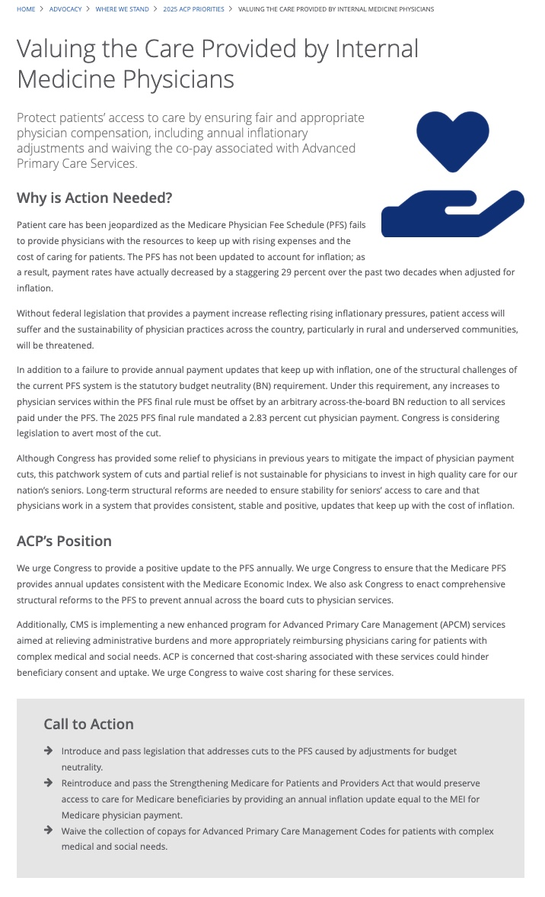
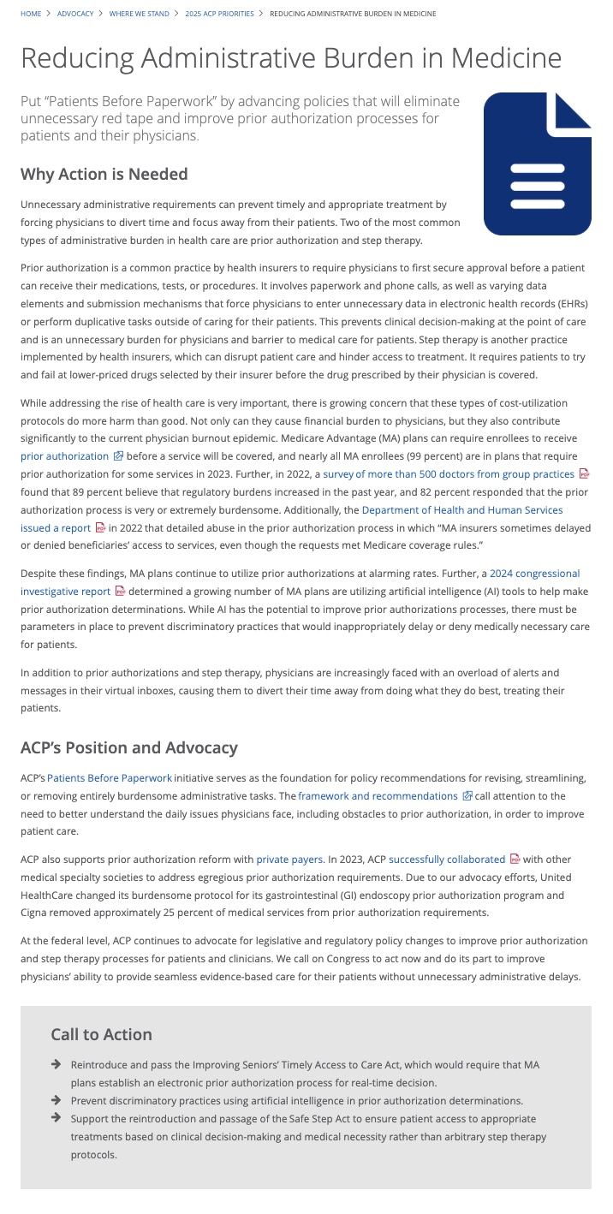
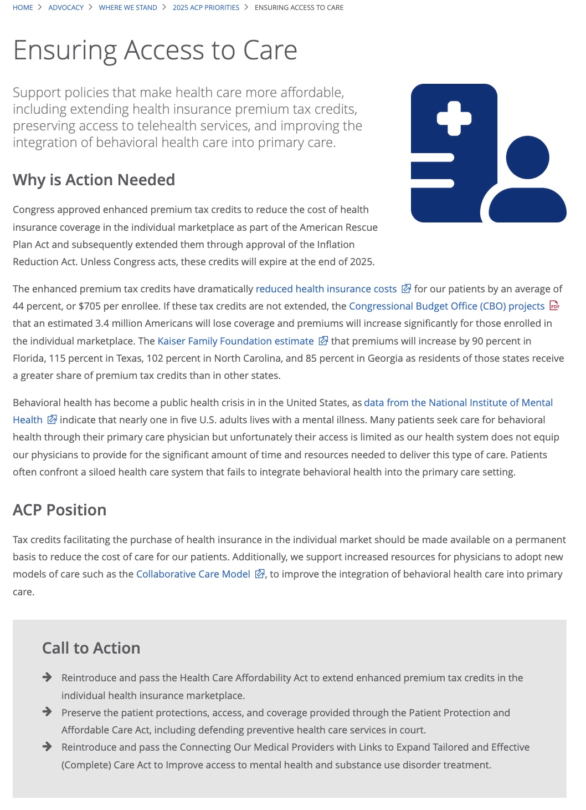

Slide 5
Congressional Activity

Slide 6
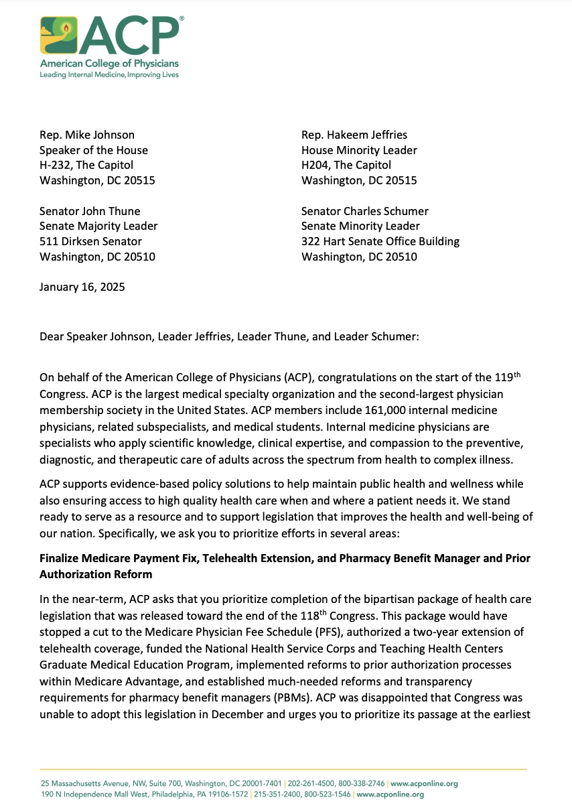
ACP’s Letter to the 119th Congress
Address Medicare payment cuts
Further extend telehealth flexibilities
Reform prior authorization in MA plans
Reform pharmacy benefit manager tactics
Extend the health insurance premium tax credits
Protect and strengthen Medicaid
Protect public health, ensuring access to vaccines

Slide 7
Medicare Patient Access and Practice Stabilization Act
Reverses the 2.83% cut that went into effect on January 1, 2025
Provides a 2% payment update (approximately half of the MEI) to provide stabilization for physicians and their practices
Would be effective April 1, 2025 through January 1, 2026

Slide 8
You can take action on Medicare physician payment

Slide 9
Budget Reconciliation: Medicaid Cuts are on the table
Per capita caps or block grants: up to $918B
Equalize the expansion population FMAP with the general FMAP: up to $690B
Limit Medicaid “provider” taxes: $175B
Lower the FMAP floor: $387B
Special FMAP treatment for DC: $8B
Repeal American Rescue Plan FMAP incentive (for non-expansion states): $18B
Medicaid work requirements: $120B
https://www.politico.com/f/?id=00000194-5115-d639-a395-7db5d6b70000

Slide 10
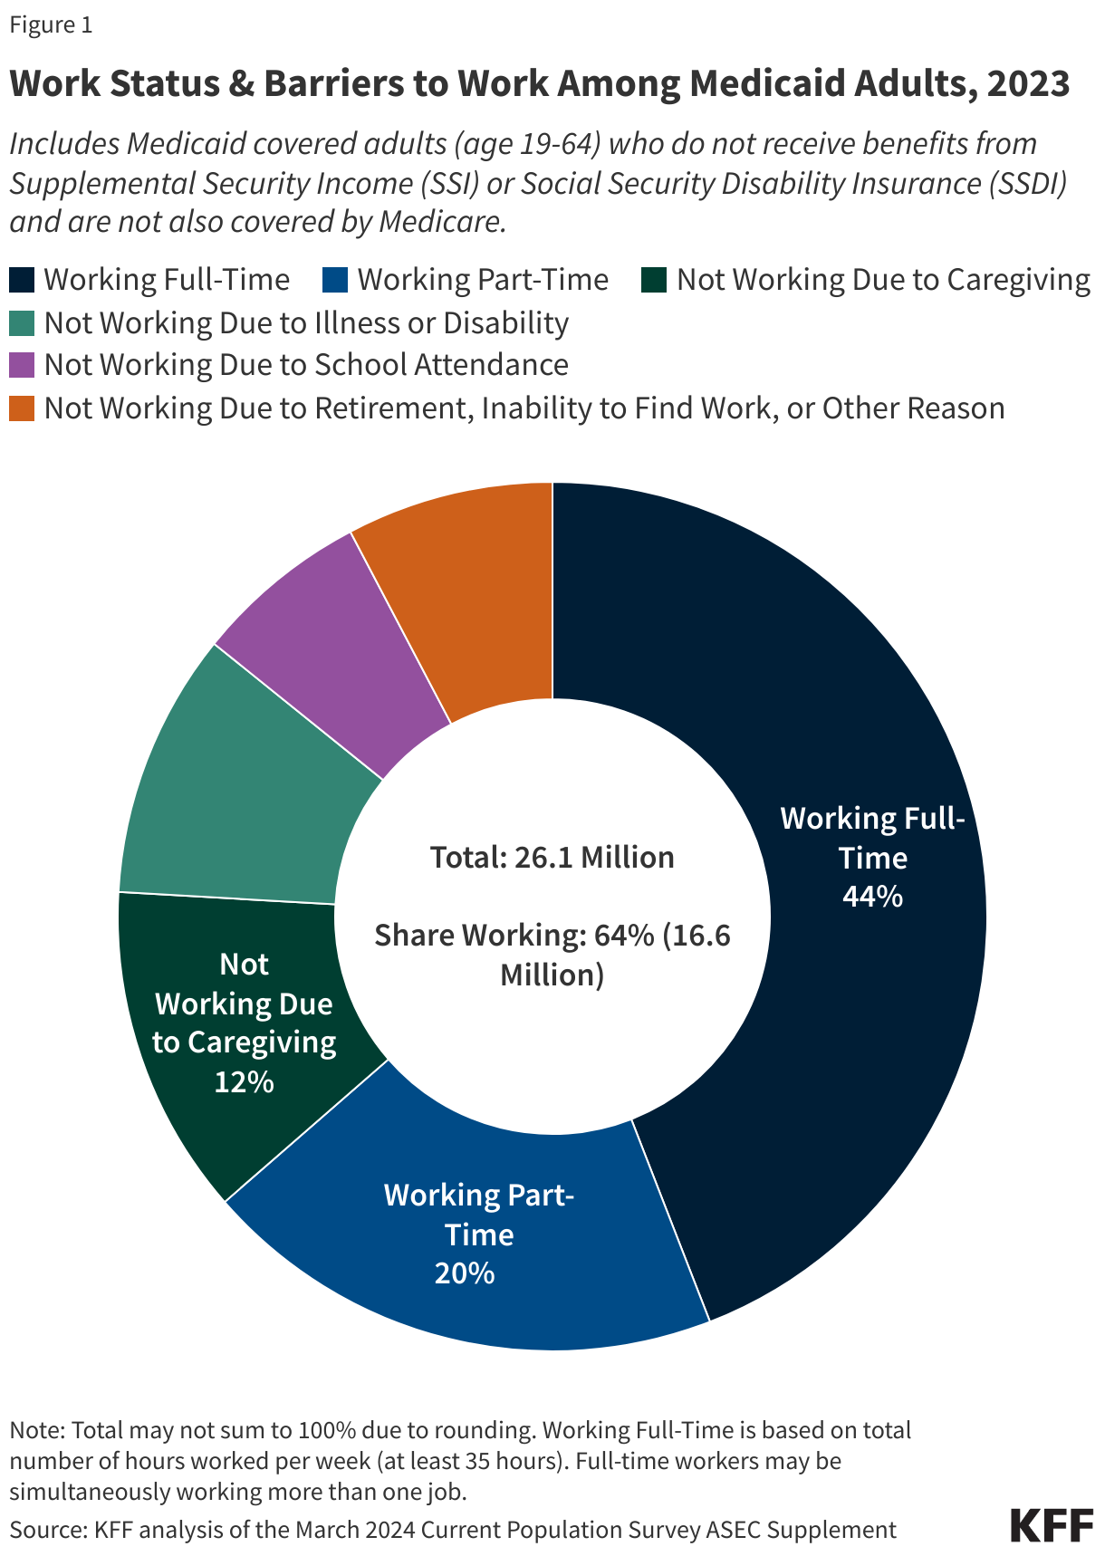
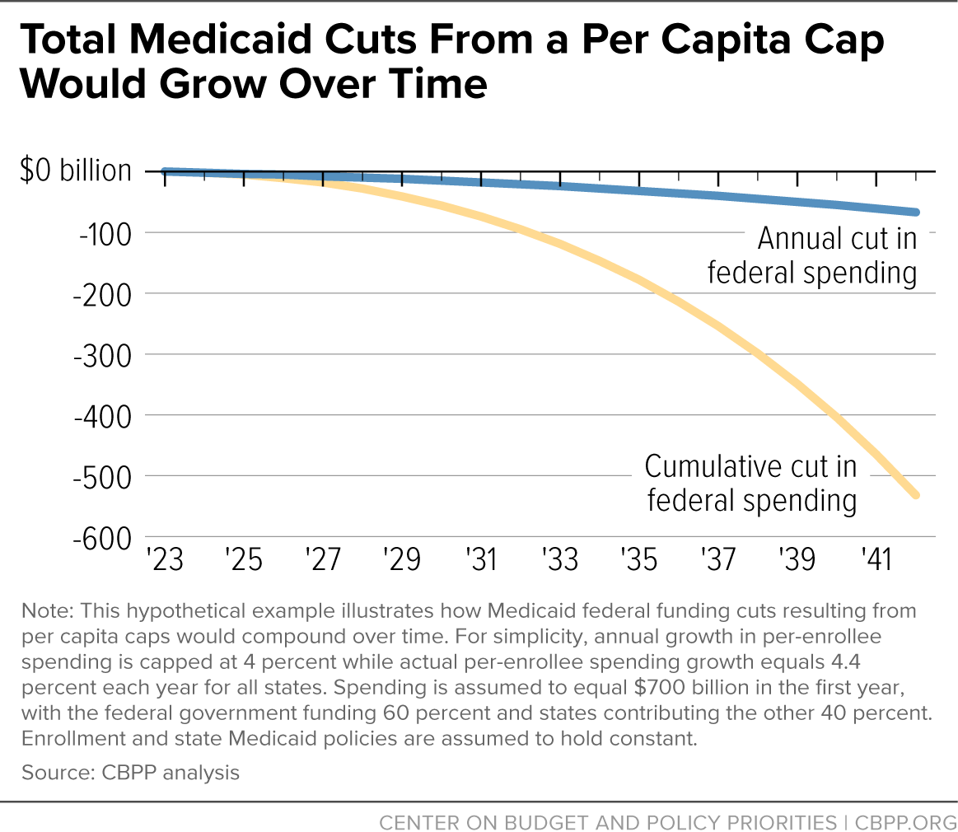

Slide 11
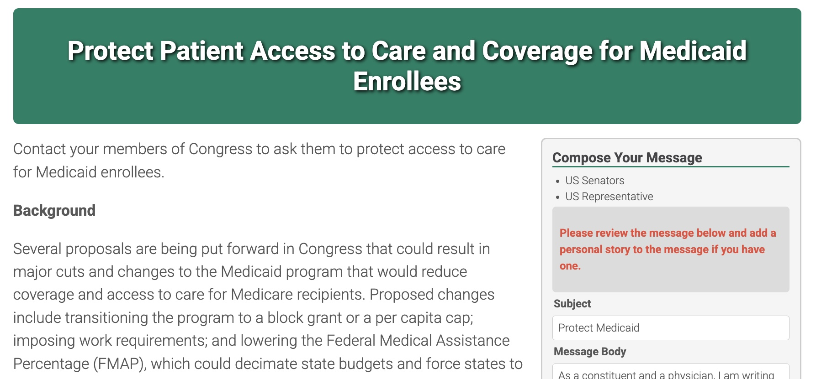
Medicaid Action Alert – Live Now!

Slide 12
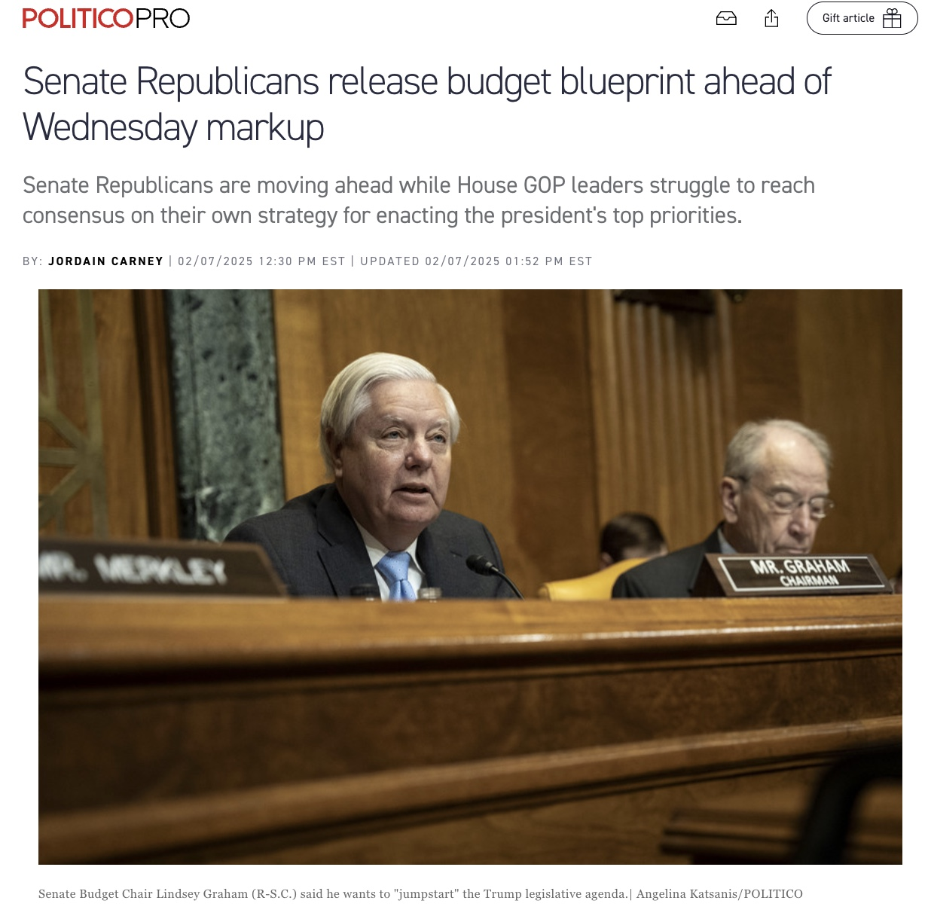
Reconciliation Status

Slide 13
Trump Administration Actions

Slide 14
DOGE looks to increase federal savings largely by investigating discretionary spending
The Department of Government Efficiency, led by Elon Musk, aims to optimize federal operations through substantial budget cuts and the elimination of unnecessary regulations and federal departments
AGENCY ACCOUNTABILITY
Federal budget cuts
Musk says that he can find $2 trillion in savings by investigating discretionary spending
Proposals have included the elimination of agencies such as the Department of Education, FBI, and IRS
Regulatory reductions
Looks to end enforcement of regulations deemed beyond agencies’ legal authority
Recommendations for regulatory rollbacks will be submitted directly to the White House for action
Federal workforce reductions
Proposes mass layoffs of federal employees as part of efforts to streamline government operations
Likely increased reliance on private-sector contractors to fulfill government functions
SECONDARY PRIORITIES
TOP PRIORITIES
PUBLIC ENGAGEMENT
Enhanced oversight of federal contracts to identify wasteful spending and potential misuse of funds
Talk of soliciting examples of inefficiency and waste through crowdsourcing on social media platforms
RAPID TIMELINE
DOGE is slated to conclude its work by July 4, 2026, coinciding with the US Semiquincentennial
SOURCE BBC, Government Executive, Reuters.
PRESENTATION CENTER 1/30/25
Notes:
Sources:
Holly Honderich, “What we know about Musk's cost-cutting mission,” BBC, December 5, 2025, https://www.bbc.com/news/articles/c23vkd57471o
Sean Michael Newhouse, “Trump’s proposed cuts to the federal workforce could increase dependency on contractors, experts say,” Government Executive, January 14, 2024, https://www.govexec.com/workforce/2025/01/trumps-proposed-cuts-federal-workforcee-could-increase-dependency-contractors-government-relations-attorneys/402190/
“Explainer: How Musk's US government efficiency panel might work,” Reuters, November 14, 2024, https://www.reuters.com/world/us/how-musks-us-government-efficiency-panel-might-work-2024-11-13/

Slide 15
Trump’s Cabinet
Council on Environmental Quality
TBD
Chief of Staff
Susie Wiles
Legislative Affairs
James Braid
OMB Director
Russell Vought
Veterans Affairs
Doug Collins
Domestic Policy
Vince Haley
Transportation
Sean Duffy
Housing and Urban Development
Scott Turner
Deputy Chief of Staff (4)
Dan Scavino, Stephen Miller, James Blair, Taylor Budowich
Cabinet Secretary
TBD
Commerce
Howard Lutnick
Agriculture
Brooke Rollins
Staff Secretary
Will Scharf
National Security Adviser (NSA)
Mike Waltz
Communications Director
Steven Cheung
Joint Chiefs of Staff
Gen. CQ Brown
Defense
Pete Hegseth
The Cabinet Table
Treasury
Scott Bessent
NSA Deputy
Alex Wong
Central Intelligence Agency (CIA)
John Ratcliffe
President
Donald Trump
Vice President
JD Vance
VP’s Chief of Staff
Jacob Reses
Environmental Protection Agency
Lee Zeldin
State
Marco Rubio
Attorney General
Pam Bondi
Media Affairs
Morgan Ackley
Drug Control Policy
TBD
Interior
Doug Burgum
Labor
Lori Chavez-DeRemer
Intergovernmental Affairs
VACANT
Council of Economic Advisers
Kevin Hassett
Health and Human Services
Robert F. Kennedy Jr.
Energy
Chris Wright
Science & Technology
Michael Kratsios
Education
Linda McMahon
Trade
Jamieson Greer
Press Secretary
Karoline Leavitt
SOURCE Politico, Washington Post, USA Today, CBS News, Axios, VA, NBC News, The Hill, Notus.
PRESENTATION CENTER 1/23/25
Notes:
Sources:
Politico Staff, “Who might make up Trump’s Cabinet,” Politico, November 6, 2024, https://www.politico.com/interactives/2024/potential-cabinets/trump-second-term-cabinet/#Labor%20Secretary
Washington Post Staff, “Tracking Trump’s picks for his Cabinet and administration,” Washington Post, Updated November 16, 2024, https://www.washingtonpost.com/politics/interactive/trump-administration-appointees/
James Powell, “Who has Trump picked for his Cabinet? Brooke Rollins rounds out nominees,” USA Today, Updated November 24, 2024, https://www.usatoday.com/story/news/politics/elections/2024/11/24/donald-trump-cabinet-picks/76548459007/
Kathryn Watson, Caitlin Yilek, “Trump administration tracker shows his latest top staff picks for his 2025 term,” CBS News, Updated December 12, 2024, https://www.cbsnews.com/live-updates/trump-administration-nominees-2025/
Stef W. Kight, “Trump taps James Braid as top congressional liaison,” Axios, November 25, 2024, https://www.axios.com/2024/11/26/trump-congress-james-braid
“VA announces Trump administration appointees,” VA, January 21, 2025, https://news.va.gov/press-room/va-announces-trump-administration-appointees/
Kierra Frazier, “Trump picks former Gingrich aide to lead Domestic Policy Council,” Politico, November 26, 2024, https://www.politico.com/live-updates/2024/11/26/congress/trumps-domestic-agenda-00191823
Garrett Haake et al., “Trump picks Rep. Mike Waltz to be his national security adviser,” NBC News, November 11, 2024, https://www.nbcnews.com/politics/donald-trump/trump-picks-rep-mike-waltz-serve-national-security-adviser-rcna179698
Ellen Mitchell, “Joint Chiefs chair says he plans to stay on under Trump,” The Hill, January 20, 2025, https://thehill.com/policy/defense/5096565-gen-cq-brown-stays-chairman-trump/
Doug Palmer et al., “Trump picks Lighthizer acolyte to be his trade chief,” Politico, November 26, 2024, https://www.politico.com/news/2024/11/26/jamieson-greer-trade-representative-trump-00191181
Brett Samuels, “Trump names top campaign aides as senior White House staff,” The Hill, November 13, 2024, https://thehill.com/homenews/campaign/4988270-trump-white-house-staff-stephen-miller-scavino-blair-budowich/
Irie Sentner, “Trump taps personal lawyer Will Scharf for White House staff secretary,” Politico, November 16, 2024, https://www.politico.com/news/2024/11/16/trump-personal-lawyer-white-house-staff-secretary-00190026
“Trump to tap campaign spokesperson Steven Cheung as communications director,” Politico, November 15, 2024, https://www.politico.com/news/2024/11/15/trump-transition-steven-cheung-communications-director-00189857
Sophia Vento, “Trump names Seb Gorka, Alex Wong to be senior national security staff,” The Hill, November 22, 2024, https://thehill.com/policy/national-security/5005747-seb-gorka-alex-wong-national-security/
Reese Gorman, “JD Vance Is Bringing His Senior Senate Staff to His VP Office,” Notus, January 17, 2025, https://www.notus.org/trump-transition/jd-vance-senior-staff-vp-office

Slide 16
President Trump Nominations for Key Health Care Positions
AGENCY | POSITION | NOMINEE | SENATE CONFIRMATION? | STATUS
Department of Health and Human Services | Secretary | Robert Kennedy Jr | Yes | Ready for vote
 | Deputy secretary | Jim O’Neill | Yes | In committee
 | Assistant secretary for health | − | Yes | No nominee
 | Assistant secretary for preparedness and response | − | Yes | No nominee
 | Surgeon General | Janette Nesheiwat | Yes | In committee
 | CMS Administrator | Mehmet Oz | Yes | In committee
 | CDC Director | Dave Weldon | Yes | In committee
 | FDA Commissioner | Marty Makary | Yes | In committee
SOURCE Washington Post.
PRESENTATION CENTER 2/3/25
Notes:
Sources:
“Donald Trump has picked 92 nominees to fill key roles in his administration so far,” Washington Post, accessed January 27, 2025, https://www.washingtonpost.com/politics/interactive/2025/trump-appointee-tracker/

Slide 17
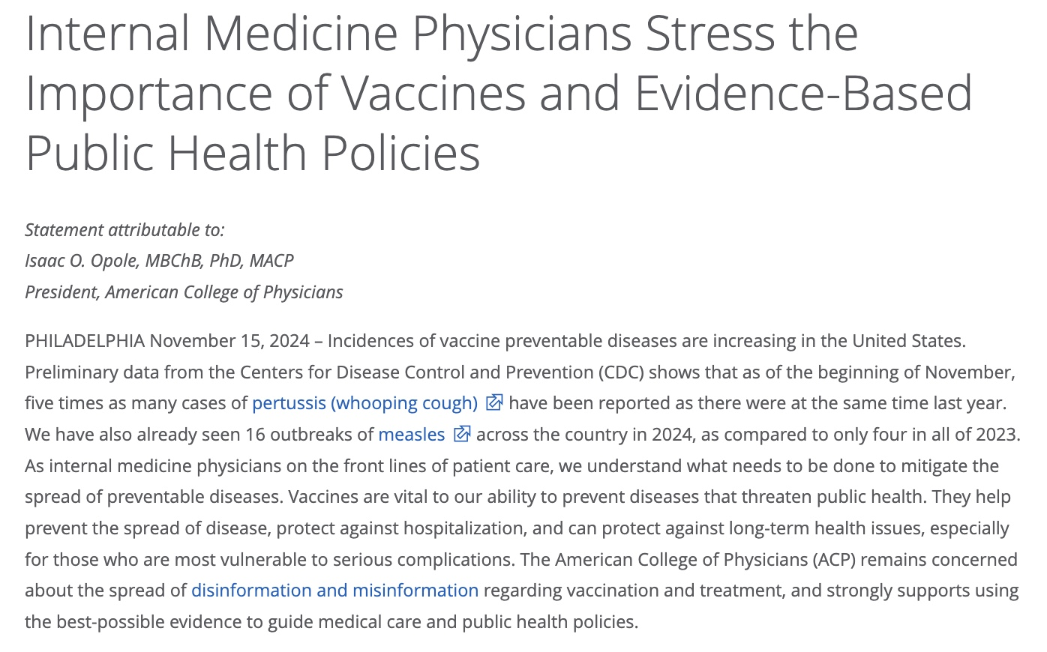
ACP’s Reaction and Ongoing Approach
The College typically does not comment on individuals named as nominees for federal offices and as such ACP has not commented on any of the nominees that President-elect Trump has named.
That said, ACP is communicating with the incoming administration and the new Congress to let them know about our priorities for the American health care system and our patients, stressing the importance of using the best-possible evidence to guide medical care and public health policies.

Slide 18
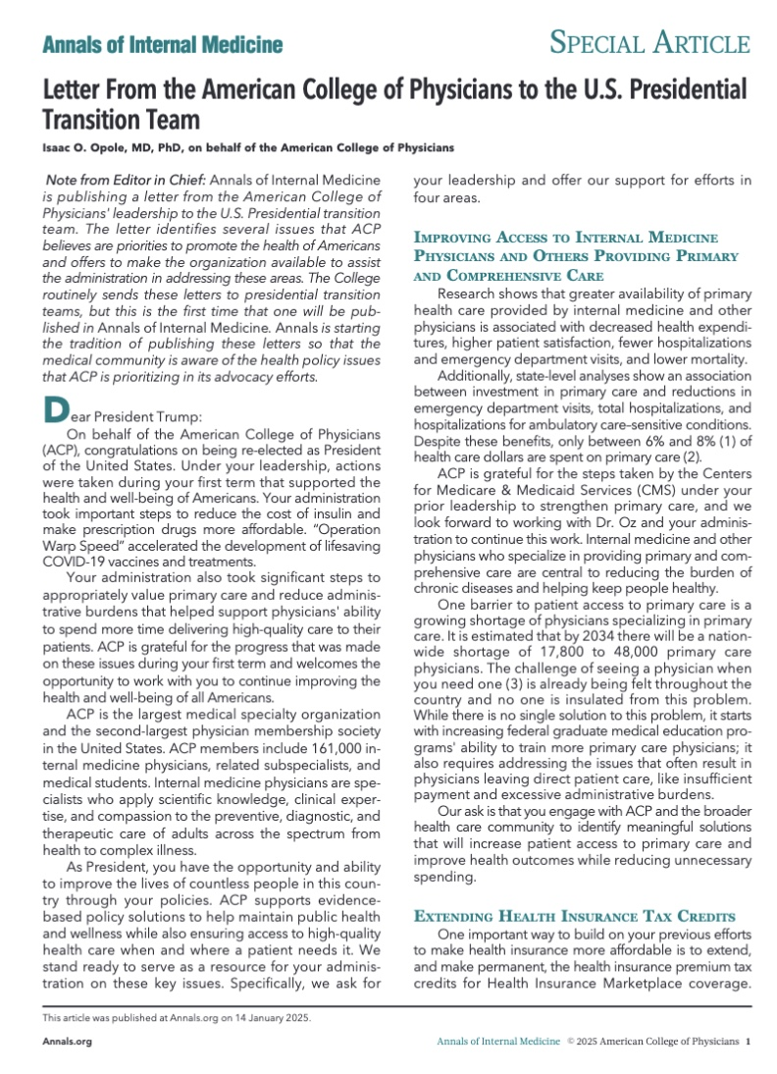
ACP is Communicating with the New Administration
Improving Access to Internal Medicine Physicians and Others Providing Primary and Comprehensive Care
Extending Health Insurance Tax Credits
Removing Unnecessary Red Tape to Improve Patient Care – addressing prior authorization
Protecting Public Health – access to vaccines
Notes:
Thank you, Dr. Moyer for your kind introduction.
ACP Submitted our letter to the incoming Trump Administration transition team on December 30th, 2024 – and it was just published in Annals of Internal Medicine on January XX, 2025.
We sought publication of this letter to raise awareness among our members and the broader public about some of our key priorities of the coming years ahead.
The policy priorities we included in the letter are - first, improving access to internal medicine physicians and others providing primary and comprehensive care. As you all know, a key barrier to access to primary care is a growing shortage of physicians specializing in primary care. In fact, it is estimated that by 2034 there will be a nationwide shortage of 17,800 to48,000 primary care physicians. Therefore, we asked the incoming Trump Administration to engage with ACP and the broader health care community to identify meaningful solutions that will increase patient access to primary care and improve health
outcomes while reducing unnecessary spending.
Secondly, we highlighted the fact that the Congressional Budget Office projects that an estimated 3.4 million Americans will lose their health insurance coverage if these tax credits are not extended. Therefore, we are pushing form them to extend the critically important health insurance tax credits that are set to expire at the end of this year.
Third, one area where we worked very successfully with the previous Trump Administration was on is addressing administrative burden. Given this, we are pushing the Administration to work with Congress to implement policy changes to minimize and improve prior authorization and step therapy processes for patients and clinicians.
Finally, we felt it was critically important to highlight the need to protect the U.S. public health infrastructure, with a particular focus on vaccines, noting how vital they are to our ability to prevent diseases that threaten public health, including novel diseases and future pandemics.

Slide 19
Trump issued twenty-six executive orders on his first day back in office
EXECUTIVE ORDERS SIGNED IN FIRST MONTH*
■ Inauguration Day ■ January of first year
*Only includes executive orders, graph does not include other forms of executive action (proclamations, memorandums, or discretionary executive actions)
SOURCE Federal Register, Time.
PRESENTATION CENTER 2/3/25
Notes:
Sources:
“Executive Orders,” Federal Register, accessed January 20, 2025, https://www.federalregister.gov/presidential-documents/executive-orders
Miranda Jeyaretnam and Chad de Guzman, “Breaking Down All of Trump’s Day 1 Presidential Actions,” Time, January 21, 2025, https://time.com/7208691/trump-day-one-presidential-actions-executive-orders-memorandum-proclamation-explainer/

Slide 20
Some might call this “Shock and Awe”
It is certainly creating confusion

Slide 21
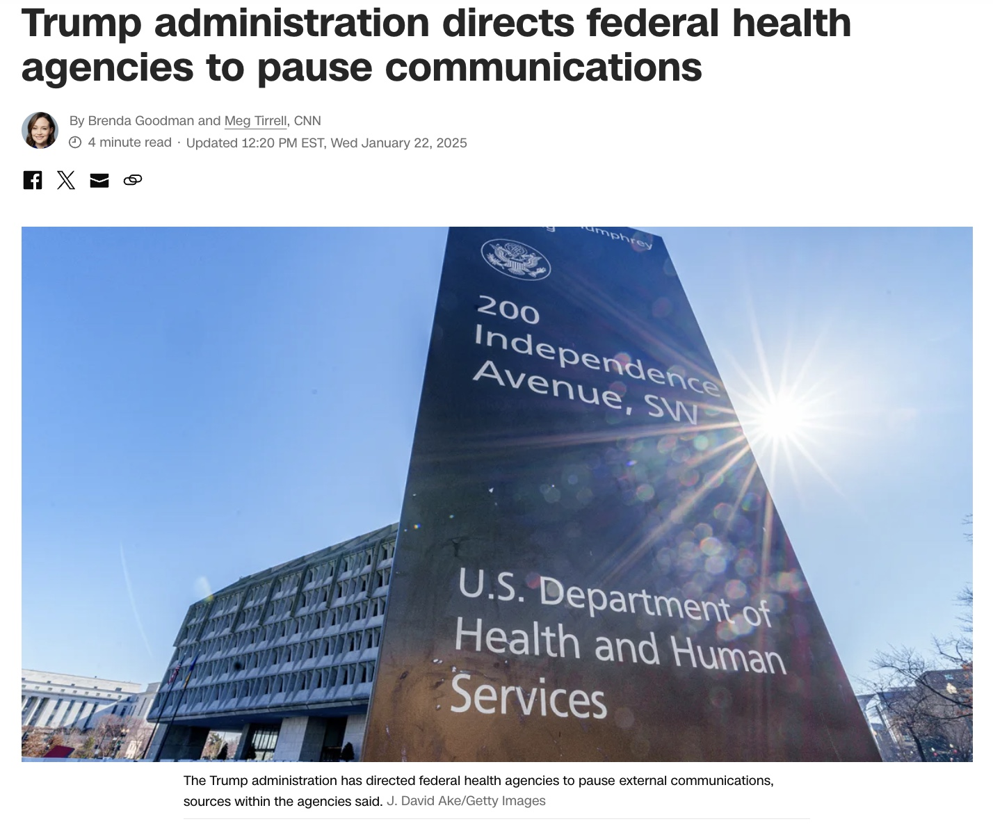
Communications Freeze – ongoing, expected to continue until confirmations are final (other than the MMWR)

Slide 22
Federal Website Changes
On Friday January 31, 2025, several federal government datasets went offline.
The datasets taken down included some widely used, large-scale national health surveys, indices, and data dashboards that inform research, policy making, and media coverage about health care and public health.
By Sunday February 2 some of the landing pages started to come back online – now with a warning message: “CDC’s website is being modified to comply with President Trump’s Executive Orders,” suggesting there could be future changes.
On Tuesday, February 4, Doctors for America filed a lawsuit in Washington, D.C. federal court, that the U.S. Centers for Disease Control and Prevention has removed "numerous" longstanding websites since the order.
ACP issued a statement with the Group of 6 (ACP, AAFP, AAP, AOA, APA, ACOG) expressing our concerns.
As of yesterday, the court ordered all webpages be restored!

Slide 23
Funding Freeze – An Ongoing Saga
On January 20, 2025, President Donald Trump signed several executive orders pausing several federal funding streams.
The following week, OMB issued Memo M-25-13, which paused the obligation or disbursement of all federal financial assistance and other activities that may be implicated by the President’s executive orders.
On January 31, US District Judge John McConnell (District of Rhode Island) issued a temporary restraining order against funding pauses arising out of Memo M-25-13 and the executive orders.
On February 10, A federal judge said that President Trump has violated his order to lift a blanket freeze on federal spending and again directed the administration to release the funds.

Slide 24
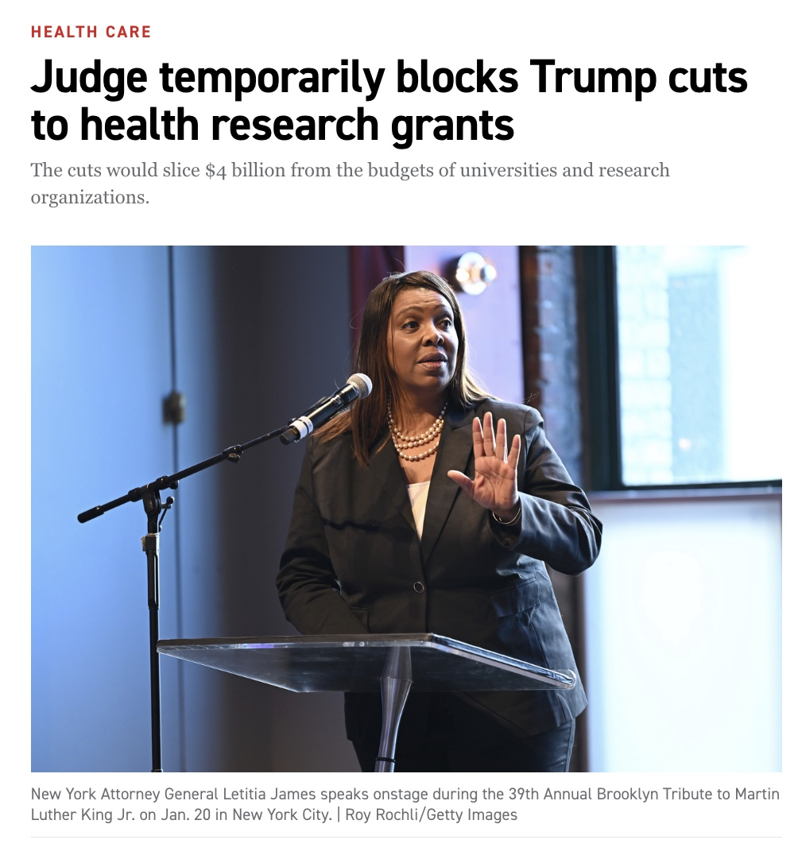
NIH Indirect Funding Cuts
On February 7, NIH released guidance stating: “For any new grant issued, and for all existing grants to IHEs retroactive to the date of issuance of this Supplemental Guidance, award recipients are subject to a 15 percent indirect cost rate.”
Significant concerns were raised about the impact of this change.
On February 10, these cuts were temporarily blocked - BUT only in the 22 states that brought the suit forward.

Slide 25
Executive orders give presidents the power to enact policy that bypasses Congress
WHAT IS AN EXECUTIVE ORDER?
Executive order: an official document signed by the president declaring government policy
The purpose of an executive order is to give instructions to government agencies and departments about how to execute and enforce legislation
In recent years executive orders have been used more broadly to instruct agencies and departments how to operate in certain policy areas
Courts may declare executive order unconstitutional if it oversteps the executive power granted by law
Judges may postpone enforcement of executive order until a final judgement has been made
Checks by other government branches
JUDICIARY
Congress may pass legislation revoking or modifying the powers it gave to a president through previous legislation
If vetoed by the president, Congress can override with 2/3 majority vote in both chambers
CONGRESS
PROCESS FOR ISSUING EXECUTIVE ORDERS:
OMB receives draft
OMB Director approves of order
AG approves of order
Director of Federal Register reviews order
President signs order
Order published in Federal Register
SOURCE Congressional Research Service, National Constitution Center.
PRESENTATION CENTER 2/3/25
Notes:
Sources:
“Executive Orders: An Introduction”, Congressional Research Service, March 29 2021, https://crsreports.congress.gov/product/pdf/R/R46738
“Executive Orders 101: What are they and how do Presidents use them?”, National Constitution Center, January 23 2017, https://constitutioncenter.org/blog/executive-orders-101-what-are-they-and-how-do-presidents-use-them

Slide 26
EO on US Withdrawal from WHO – Group of 6 Statement
The WHO plays many critical roles including:
Financially, the US is the largest funder of WHO efforts, so our withdrawal will have a significant impact on their operations finances
Our withdrawal also will have an impact on our reputation as a country that can be depended on to provide aid during health crises.
Additionally, should a disease arise somewhere in the world and the US is not a part of the WHO, we will not be informed in a timely manner or have the data necessary to plan a response.
detecting, monitoring, and responding to health threats across the globe;
gathering and evaluating data on global health status; setting standards and guidelines for how to deal with health threats;
providing goods, like vaccines, to improve health;
assisting in humanitarian responses; and
providing technical assistance.

Slide 27
Trump executive orders: Government reform (1/4)
DATE | EXECUTIVE ORDER | DETAILS
1/20/25 | Ending Radical and Wasteful Government DEI Programs and Preferencing | Terminates diversity, equity, and inclusion (DEI) programs in federal agencies, emphasizing merit-based employment and equal dignity while requiring review and compliance within 60 days
1/20/25 | Defending Women From Gender Ideology Extremism and Restoring Biological Truth to the Federal Government | Defines 'sex' strictly as biological male or female, mandates federal policies and documents align with this definition, and prohibits funding or promotion of gender ideology.
1/20/25 | Establishing and Implementing the President’s “Department Of Government Efficiency” | Establishes the Department of Government Efficiency and the US DOGE Service to modernize federal technology and software, improve interoperability, and enhance government productivity
1/20/25 | Organization of the National Security Council and Subcommittees | Reorganizes the National Security Council (NSC) to enhance interagency coordination and decision-making on national and homeland security issues, aligning processes to address evolving threats
1/20/25 | Restoring Accountability for Career Senior Executives | Strengthens accountability and performance expectations for Senior Executive Service officials to ensure alignment with the President’s policy priorities and effective execution of federal responsibilities
SOURCE White House.
PRESENTATION CENTER 2/3/25
Notes:
Sources:
“Presidential Actions,” White House, accessed January 21, 2025, https://www.whitehouse.gov/presidential-actions/

Slide 28
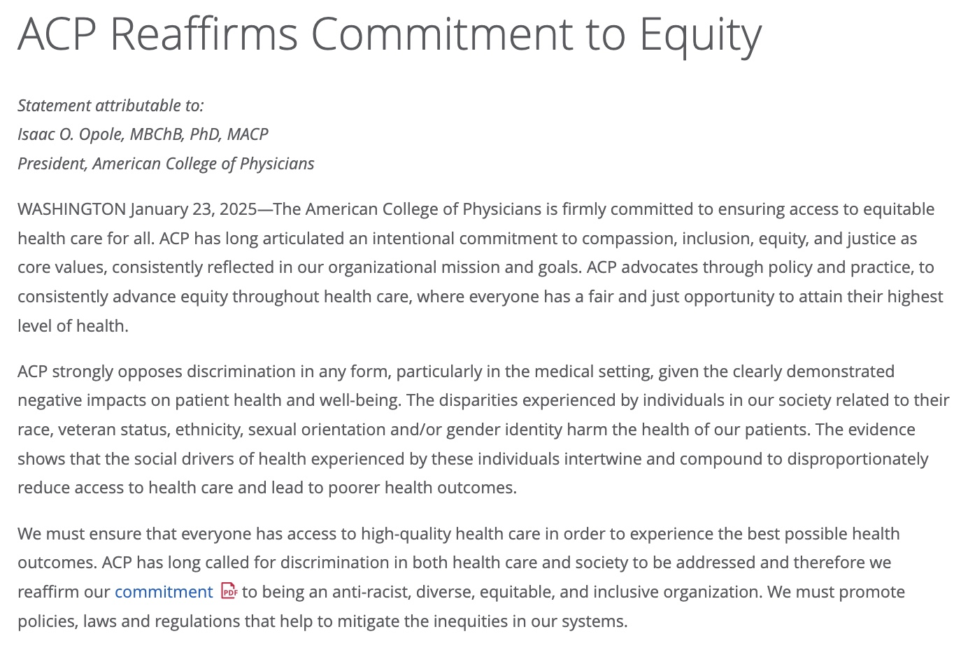

Slide 29
Trump executive orders: Government reform (2/4)
DATE | EXECUTIVE ORDER | DETAILS
1/20/25 | Restoring Accountability to Policy-Influencing Positions Within the Federal Workforce | Reinstates and amends a prior policy to increase accountability within the civil service by reclassifying certain policy-related positions for easier removal of underperforming or noncompliant employees
1/20/25 | Return to In-Person Work | Directs executive branch agencies to end remote work and to require employees to return to in-person duty, with exemptions as deemed necessary by agency heads
1/20/25 | Regulatory Freeze Pending Review | Stops new rule proposals, withdraws unpublished rules, and recommends delaying effective dates of recent regulations
1/20/25 | Hiring Freeze | Freezes federal civilian hiring across executive agencies, with exceptions for national security, public safety, and essential services
1/20/25 | Restoring Freedom Of Speech And Ending Federal Censorship | Prohibits federal entities from censoring constitutionally protected speech, and mandates investigations into past government censorship
SOURCE White House.
PRESENTATION CENTER 2/3/25
Notes:
Sources:
“Presidential Actions,” White House, accessed January 21, 2025, https://www.whitehouse.gov/presidential-actions/

Slide 30
Trump executive orders: Government reform (3/4)
DATE | EXECUTIVE ORDER | DETAILS
1/20/25 | Ending The Weaponization Of The Federal Government | Mandates reviews of federal law enforcement and intelligence activities to address alleged weaponization against political opponents and to ensure accountability for misconduct
1/20/25 | Reforming The Federal Hiring Process And Restoring Merit To Government Service | Reforms federal hiring practices focusing on merit, skill, and dedication to American values, while eliminating bias and inefficiencies
1/20/25 | Ending Radical And Wasteful Government DEI Programs And Preferencing | Mandates the termination of all federally implemented Diversity, Equity, Inclusion (DEI) and related initiatives introduced by the previous administration
1/21/25 | Keeping Americans Safe in Aviation | Mandates the FAA to prioritize merit-based hiring and to rescind all DEI initiatives
1/21/25 | Ending Illegal Discrimination and Restoring Merit-based Opportunity | Requires the removal of DEI-related policies in federal operations and contracting
SOURCE White House.
PRESENTATION CENTER 2/3/25
Notes:
Sources:
“Presidential Actions,” White House, accessed January 21, 2025, https://www.whitehouse.gov/presidential-actions/

Slide 31
Trump executive orders: Government reform (4/4)
DATE | EXECUTIVE ORDER | DETAILS
1/24/25 | Enforcing The Hyde Amendment | Reaffirms the Hyde Amendment policy by revoking prior executive orders and ending federal funding for elective abortions
1/24/25 | Council to Assess The Federal Emergency Management Agency | Establishes a council to evaluate FEMA’s effectiveness and recommend reforms to enhance disaster response, resilience, and impartiality across the US
SOURCE White House.
PRESENTATION CENTER 2/3/25
Notes:
Sources:
“Presidential Actions,” White House, accessed January 21, 2025, https://www.whitehouse.gov/presidential-actions/

Slide 32
Trump executive orders: Public health
DATE | EXECUTIVE ORDER | DETAILS
1/28/25 | Protecting Children from Chemical and Surgical Mutilation | Prohibits federal funding and support for medical interventions altering a child's sex, directs agencies to enforce restrictions, and requires HHS to review related medical guidelines and policies
SOURCE White House.
PRESENTATION CENTER 2/3/25
Notes:
Sources:
“Presidential Actions,” White House, accessed January 21, 2025, https://www.whitehouse.gov/presidential-actions/

Slide 33
Trump executive orders: Immigration (1/2)
DATE | EXECUTIVE ORDER | DETAILS
1/20/25 | Protecting The United States From Foreign Terrorists and Other National Security and Public Safety Threats | Enhances vetting and screening of foreign nationals to prevent entry or presence of individuals posing security threats, with stringent measures for high-risk countries and programs
1/20/25 | Securing Our Borders | Mandates comprehensive measures to secure the US southern border, including constructing barriers, detaining illegal entrants, resuming Migrant Protection Protocols, and enhancing prosecution of border-related crimes
1/20/25 | Protecting the Meaning and Value of American Citizenship | Redefines birthright citizenship to exclude individuals born in the US to parents who are unlawfully present or temporarily residing, effective 30 days after issuance
1/20/25 | Realigning the United States Refugee Admissions Program | Suspends the US Refugee Admissions Program until further review to align refugee entry with national interests, prioritize security, and ensure state and local consultation
1/20/25 | Clarifying the Military’s Role in Protecting the Territorial Integrity of the United States | Directs the Department of Defense to assign US Northern Command the mission of securing the US borders against illegal migration, trafficking, and criminal activities, prioritizing national sovereignty
SOURCE White House.
PRESENTATION CENTER 2/3/25
Notes:
Sources:
“Presidential Actions,” White House, accessed January 21, 2025, https://www.whitehouse.gov/presidential-actions/

Slide 34
Trump executive orders: Immigration (2/2)
DATE | EXECUTIVE ORDER | DETAILS
1/20/25 | Declaring a National Emergency at the Southern Border of the United States | Declares a national emergency at the southern US border, authorizing military deployment, construction of physical barriers, and enhanced strategies to secure the border and address illegal migration
1/20/25 | Protecting The American People Against Invasion | Prioritizes strict enforcement of immigration laws, directs the attorney general to research stopping federal funding to sanctuary jurisdictions, and revokes prior policies to address unauthorized entry
1/20/25 | Guaranteeing the States Protection Against Invasion | Suspends the entry of aliens engaged in an invasion at the southern US border for national security, public health, and constitutional reasons
SOURCE White House.
PRESENTATION CENTER 2/3/25
Notes:
Sources:
“Presidential Actions,” White House, accessed January 21, 2025, https://www.whitehouse.gov/presidential-actions/

Slide 35
Impact of Immigration Executive Orders
ACP is actively monitoring the immigration related executive orders and their impact on IMGs and will take action if necessary to support our IMG members. As of now, we do not see a direct negative impact on IMGs.
The ECFMG recently communicated with program directors regarding the executive orders because of match season and the rank order list, in order to reassure program directors so that IMGs are not negatively impacted.
ACP does not have policy on Temporary Protected Status. Residents with TPS can work with their lawyers to convert to a J-1 or H-1 visa. Physicians with TPS status may have more difficulty converting as they need to have a sponsor.
We have heard from an ACP Chapter regarding a recent unannounced audit at a large health system in their state. It appears that USCIS has been conducting audits (including unannounced audits) prior to this administration though perhaps they are now ramping up. We will continue to monitor this.
International Travel: While there is nothing right now that prevents IMGs from being able to return to the US if traveling abroad, the ECFMG recently encouraged caution. They are not aware of any J-1 physicians experiencing issues returning to the U.S. to date.

Slide 36
ACP has endorsed The Protecting Sensitive Locations Act
Prohibits immigration enforcement actions by DHS officers or agents at or within 1,000 feet of sensitive locations, including:
Medical treatment and health care facilities, such as hospitals, community health centers, and accredited health clinics;
Public and private schools and other education-related locations, such as pre-schools, Head Start programs, early care and education programs, K-12 schools, colleges, universities, trade schools, school bus stops, and during school field trips;
Places where children gather, such as playgrounds, recreation centers, and child care centers;
Places providing social services, including disaster or emergency response relief, such as food banks and pantries, shelters, the office of an individual’s lawyer, community-based organizations, public libraries, union halls, and other organizations and centers that provide assistance;
Places of worship, such as churches, mosques, and synagogues;
Religious or civil ceremonies or observances, such as sites of funerals and weddings;
During public demonstrations, such as a march, rally, or parade;
Government buildings, such as federal, state, or local courthouses, Congressional district offices, Social Security offices, public assistance offices, and the Department of Motor Vehicles.
Establishes exceptions for sensitive locations in the case of exigent circumstances, such as imminent risk of death, violence, or threat to public safety. Additionally, sensitive locations do not apply to the transportation of an individual apprehended at the border to a medical facility to receive care. .
Requires annual training for DHS officers on the sensitive locations policy and annual reporting from DHS regarding enforcement actions or complaints of enforcement actions at sensitive locations.
Prevents information from being entered into the record in a removal proceeding resulting from a violation of the sensitive locations policy and allows for the immediate termination of the removal proceeding in that instance.

Slide 37
What’s next?
EO expected any day that will potentially call for cutting HHS staff back by 50%
Further litigation on many of the EOs
Likely confirmation of RFK Jr.
Hopefully, some movement from the House on reconciliation
Lots of unknowns

Slide 38
So, what should ACP do?
Continue to monitor all this activity
Make public statements as needed
Send letters to and hold meetings with lawmakers and Administration officials
Engage in judicial advocacy – e.g., amicus briefs
You can also help!
Become a member of the ACP Advocates for Internal Medicine Network (AIMn) – and send critical messages to your policymakers
Consider writing op eds for your local and state papers
Contact your state and federal lawmakers directly – build those relationships!

Slide 39
In other words…

Slide 40
Q & A

