Slide 1
August Recess 2024 Advocacy Issues & Grassroots Mobilization Challenge
David Pugach, JD
Vice President, Governmental Affairs and Public Policy

Slide 2
There are a Limited Number of Legislative Days Left in 2024
Notes:
-40 legislative days until end of 118th Congress
- FY25 appropriations
NDAA
WRDA
Farm Bill
FAA

Slide 3
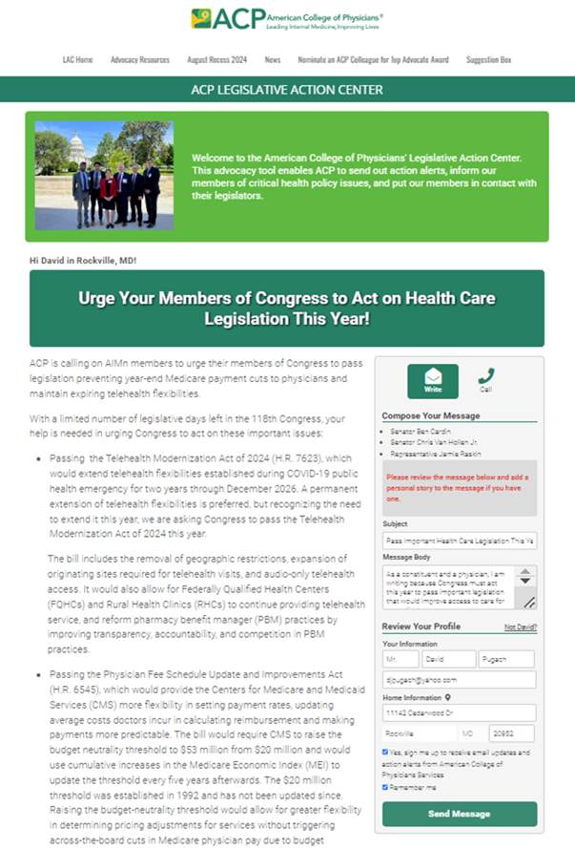
August Recess 2024 Priority Issues
The Telehealth Modernization Act of 2024 (H.R. 7623)
The Physician Fee Schedule Update and Improvements Act of 2024 (H.R. 6545)

Slide 4
Telehealth
Use of telehealth expanded significantly during COVID-19 pandemic.
Congress authorized new coverage and flexibility for telehealth during pandemic.
Current/expiring extension of pandemic-era telehealth flexibilities, include:
Removes geographic restrictions
Recognizes audio-only services
Extends to rural health clinics and federal health centers

Slide 5
Telehealth Modernization Act of 2024 (H.R. 7623)
Telehealth Modernization Act:
Would permanently extends certain flexibilities that were initially authorized during the public health emergency relating to COVID-19. Including:
(1) rural health clinics and federally qualified health centers to serve as the distant site;
(2) the home of a beneficiary to serve as the originating site for all services; and
(3) all types of practitioners to furnish telehealth services, as determined by CMS.

Slide 6
Telehealth Modernization Act of 2024 (H.R. 7623) Cosponsors
Introduced by Rep. Carter (R-GA-1)
17 cosponsors:
Rep. Blunt Rochester (D-DE-At Large)*
Rep. Steube (R-FL-17)*
Rep. Sewell (D-AL-7)*
Rep. Miller-Meeks (R-IA-1)*
Rep. Dingell (D-MI-6)*
Rep. Van Drew (R-NJ-2)*
Rep. Morelle (D-NY-25)*
Rep. Harshbarger (R-TN-1)
Rep. Lofgren (D-CA-18)
Rep. Pence (R-IN-6)
Rep. Ross (D-NC-2)
Rep. Gottheimer (D-NJ-5)
Rep. Franklin (R-FL-18)
Rep. Lawler (R-NY-17)
Rep. Mann (R-KS-1)
Rep. Suozzi (D-NY-3)
Rep. Nickel (D-NC-13)
Notes:
9D and 8R

Slide 7
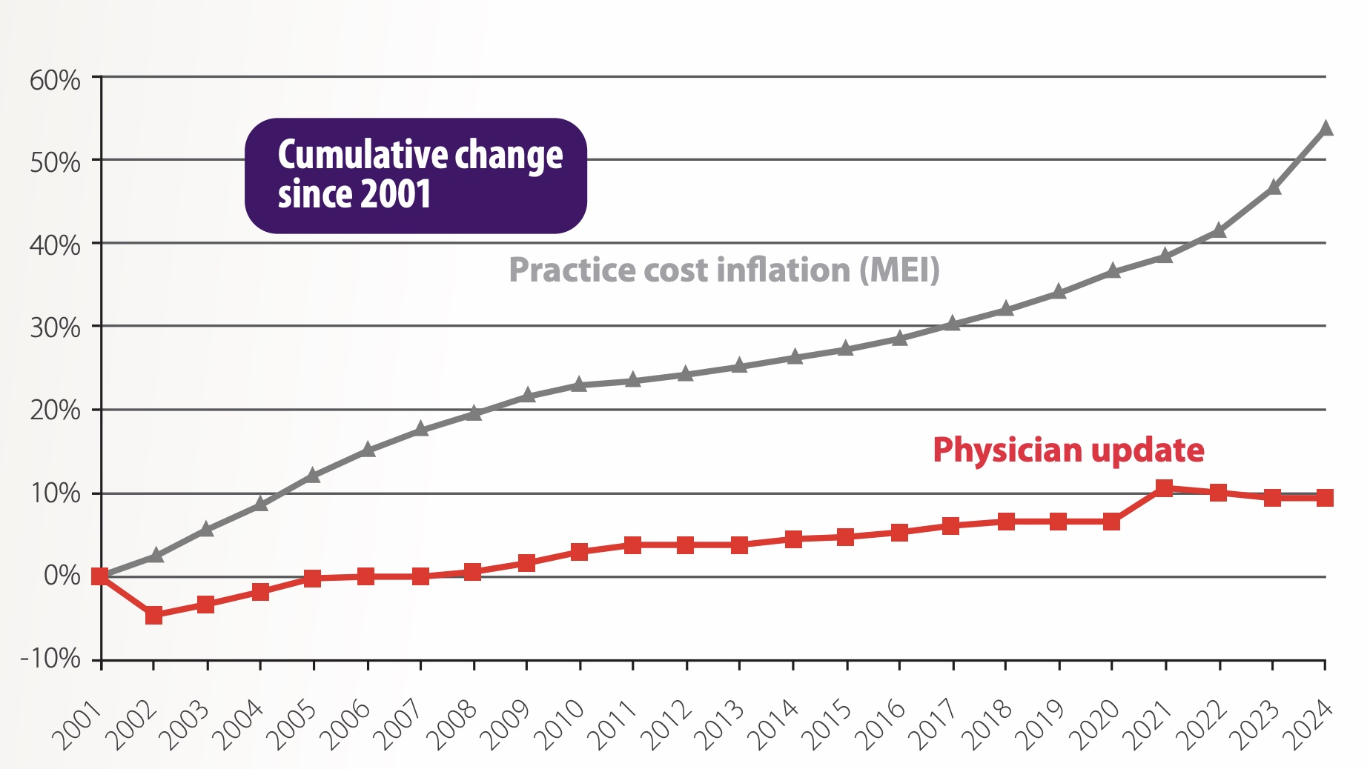
Major Challenges with Physician Payment
Medicare Economic Index
Budget Neutrality
Notes:
Two compounding issues that are hurting Medicare payment for physicians:
Budget neutrality
Frozen MEI
30% decline in Medicare payment when accounting for inflation.
ACP working to address both issues
-

Slide 8
CORRECTION: The Physician Fee Schedule Update and Improvements Act (H.R. 6545)
H.R. 6545 would:
Raise the threshold for implementing budget neutral payment cuts from $20 million to $53 million
Would provide an increased update to the threshold every five years afterwards based on the MEI
Update practice expense inputs, such as clinical labor costs, at least every five years
H.R. 6545 was passed out of the House Energy and Commerce Committee on December 6, 2023 – but it still needs to move forward in the House. Senate version being introduced soon!
No CBO cost estimate is available at this time.

Slide 9
Physician Fee Schedule Update and Improvements Act (H.R. 6545) Cosponsors
Introduced by Rep. Miller-Meeks (R-IA-1)
18 cosponsors:
Rep. Buschon* (R-IN-8)
Rep. Schrier* (D-WA-8)
Rep. Kelly* (D-IL-2)
Rep. Burgess* (R-TX-26)
Rep. Murphy* (R-NC-3)
Rep. Bera* (D-CA-6)
Rep. Cardenas* (D-CA-29)
Rep. Ruiz (D-CA-25)
Rep. Hudson (R-NC-9)
Rep. Joyce (R-PA-13)
Rep. Davis (D-NC-1)
Rep. Reschenthaler (R-PA-14)
Rep. Estes (R-KS-4)
Rep. Bentz (R-OR-2)
Rep. Soto (D-FL-9)
Rep. Norcross (D-NJ-1)
Rep. Caraveo (D-CO-8)
Notes:
9D and 9R
7 physicians

Slide 10
August Recess Advocacy Mobilization Challenge

Slide 11
ACP Legislative Action Center – August Recess Content

Slide 12
Grassroots Alert

Slide 13
August Recess 2024 -- Grassroots Mobilization Challenge
The Advocates for Internal Medicine Network (AIMn) is challenging ACP members to mobilize on these two important bills during the August recess
For different advocacy actions taken from July 29 through September 5, you can score points for your state:
5 points for every person who sends an email message through the action alert
25 points for every person who calls their representatives through the action alert
100 points for every meeting held with a member of Congress
States with the highest engagement will be recognized in a broadcast to the AIMn and on the next State Health Policy Webinar this fall, as well as anyone who holds a meeting with their representatives during the recess

Slide 14
August Recess 2024 -- Grassroots Mobilization Challenge
More information and resources for the grassroots challenge are posted on ACP's Legislative Action Center
Action alert link
Step-by-step guide for requesting meetings with Congressional offices during recess
One-pager describing the issues, for educating yourself or for sharing with Congressional offices after meeting
While we encourage all members to participate as fully as possible in the challenge, be sure to connect with your chapter if you are interested in requesting a meeting with a member of Congress.

Slide 15
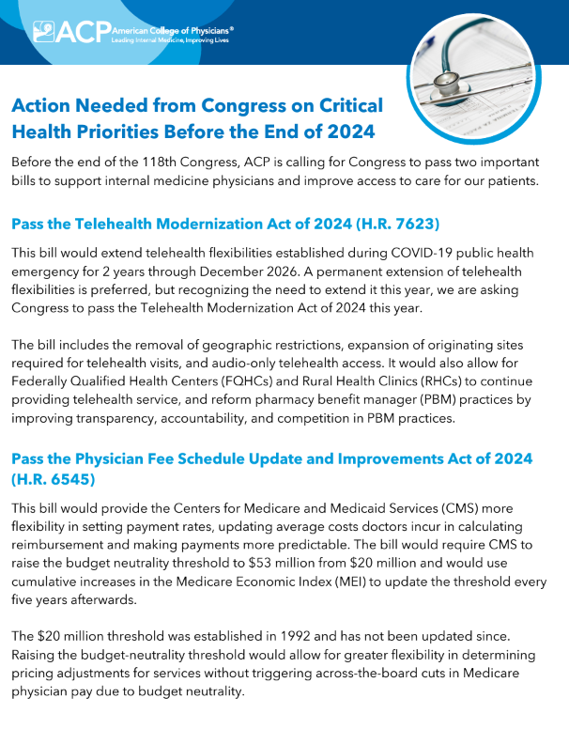

Slide 16
Questions?

