Slide 1
2023-2024 Supreme Court Term Review
Jessica Morton
Senior Counsel
July 2024

Slide 2
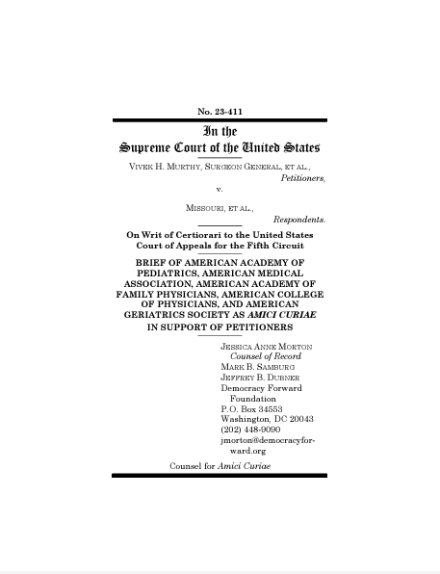
Amicus Briefs| What are they?
Friends of the court
Not parties in a case
Offering special expertise and insight to be helpful to the court

Slide 3
Amicus Briefs| Strategic Counterweights in Court
Understand the value of non-traditional voices and perspectives (i.e. what would the salient voice be?) ensure they are in court
Understand what needs to be written for history and longer term legal development
Coordinating coalitions to ensure better coverage in court
Link to public narrative
Put down markers for future cases after SCOTUS issues decisions
Physicians and experts in pharmaceutical and regulatory policy
Originalist scholar
Groups representing more than 250,000 small businesses
Agriculture, rural focused organizations

Slide 4
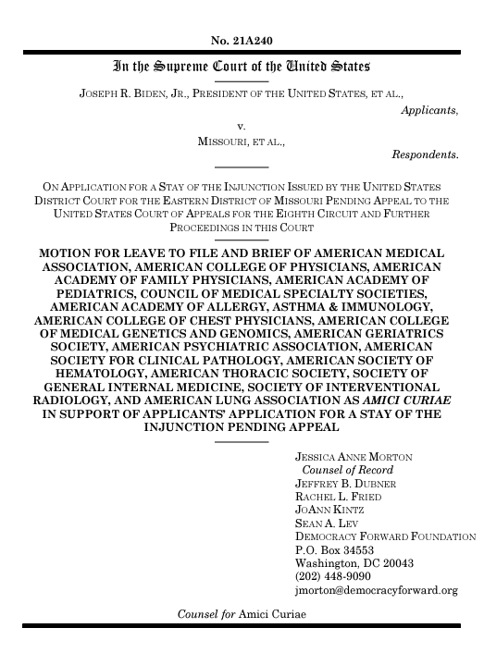
Amicus Briefs | Strategic Counterweights in Court
All this is perhaps why healthcare workers and public health organizations overwhelmingly support the Secretary’s rule. See id., at 61565–61566; see also Brief for American Medical Assn. et al. as Amici Curiae; Brief for American Public Health Assn. et al. as Amici Curiae; Brief for Secretaries of Health and Human Services et al. as Amici Curiae. Indeed, their support suggests that a vaccination requirement under these circumstances is a straightforward and predictable example of the “health and safety” regulations that Congress has authorized the Secretary to impose. We accordingly conclude that the Secretary did not exceed his statutory authority in requiring that, in order to remain eligible for Medicare and Medicaid dollars, the facilities covered by the interim rule must ensure that their employees be vaccinated against COVID–19.

Slide 5
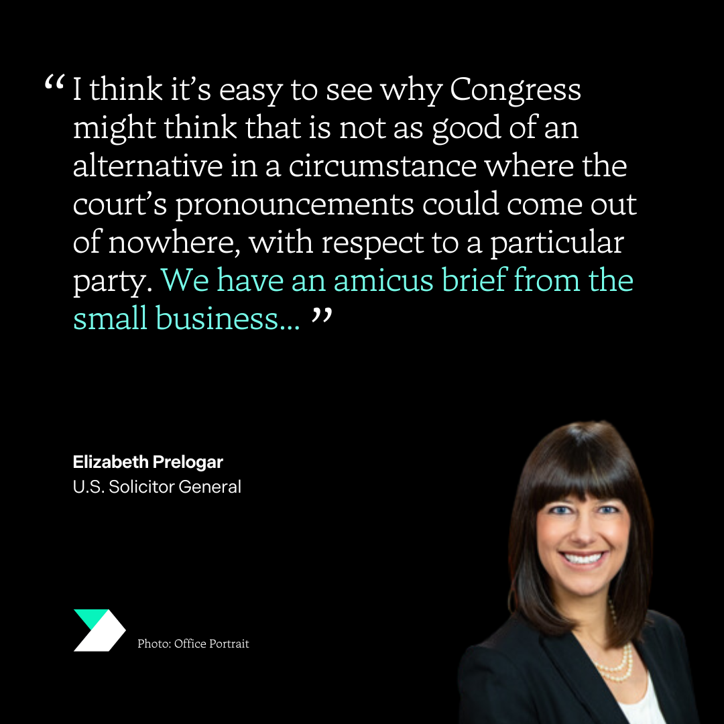
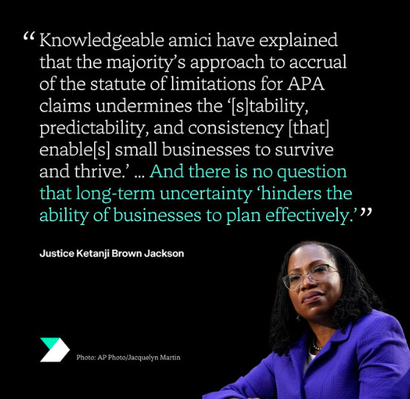
Amicus Briefs | Strategic Counterweights in Court
Notes:
(Loper Bright / Relentless, CP)

Slide 6
Key Cases | Recap In Brief
Relentless v. Department of Commerce and Loper Bright v. Raimondo
Corner Post v. Federal Reserve System
Murthy v. Missouri
Idaho and Moyle, et al v. United States
AHM v. FDA

Slide 7
Loper Bright v. Raimondo &
Relentless v. Dept of Commerce
Chevron Deference: A 40+ year doctrine that governed whether agencies have the right to apply their expertise to interpret and implement laws.
The Supreme Court overturned this doctrine, ruling that judges need not defer to agencies when interpreting laws.
This will affect every federal agency, including those that relate to medical practice.

Slide 8
Corner Post v. Federal Reserve System
The Supreme Court ruled that attacks against long-standing agency actions and regulations are allowed.
A harmful ruling in Corner Post—coupled with bad decisions in the Supreme Court cases Relentless v. Department of Commerce and Loper Bright Enterprises v. Raimondo—can open up a Pandora’s box of attacks on a wide swath of regulations.
Expect to see a flood of litigation by special interests challenging any policy or regulation that doesn’t fit their short-term agenda, even years after the fact, and undermining our government’s ability to work for all people.

Slide 9
Murthy v. Missouri
Social media users and state Attorneys General sought a ruling that would prevent any presidential administration from encouraging social media companies to deplatform dangerous misinformation and disinformation.
The district court initially told the executive branch that it couldn’t communicate with any social media company at all. But the Supreme Court narrowed that initial ruling, and eventually found that the plaintiffs didn’t have standing to bring the case.
But the district court has another month to decide if a separate group of plaintiffs have standing, so the case may continue.

Slide 10
Idaho v. US & Moyle v. US
Concerns scope federal law and preemption after Dobbs.
EMTALA guarantees access to emergency care for pregnant patients, which may include abortion care. Idaho has a total ban on abortions, with a life exception only, threatening the health of patients and criminalizing doctors for providing abortions under EMTALA.
The Biden administration sued Idaho. In a one sentence order, the Supreme Court held that the case was taken up in error, dismissed the case, and reinstated a lower court’s order to block the ban.
The Court did not reach the question of whether Idaho’s abortion ban is allowed to stand.

Slide 11
Idaho v. US & Moyle v. US: What’s Next?
The case will be reviewed by the Ninth Circuit to decide whether Idaho’s abortion ban improperly conflicts with EMTALA
Broader trend with far-right groups seeking to “over read” Dobbs and suggest some inherent power from states (or “major question”) and undermine federal preemption.
Argument that because Congress passed EMTALA through spending clause that somehow the supremacy clause does not apply
Other Litigation:
Texas v. Becerra: Texas challenged Biden administration post-Dobbs guidance that EMTALA may require abortions in emergency cases; DOJ has appealed to SCOTUS

Slide 12
Impact on Physician Practice
SCOTUS “kicked the can”
Biden admin will continue to enforce EMTALA (except in TX)
Exceptions to state abortion bans remain undefined and problematic
Challenges to state bans by patients denied care and providers continue in TN and ID after Texas Supreme Court refused to clarify the Texas exceptions

Slide 13
Alliance for Hippocratic Medicine v. FDA
In 2000, FDA approved mifepristone as safe and effective for use
Anti-choice groups sued to restrict access to mifepristone, calling into question FDA’s long-standing authority
The case was appealed to the Supreme Court after the Northern District of Texas and the Fifth Circuit ruled that the FDA’s actions were illegal

Slide 14
AHM v. FDA: Decision
The Supreme Court held unanimously that AHM did not have standing to bring this lawsuit.
The ruling stated that anti-choice physicians do not experience sufficient harm.
The Court did not make any rulings about any other aspect of the case, remanding for further action.
The case returns to the Northern District of Texas, where the judge will decide whether state AGs can continue the case.
Notes:
Related litigation:
Challenges to FDA’s Risk Evaluation and Mitigation Strategies (REMS) - Washington, Hawaii, Virginia
FDA preemption cases - West Virginia, North Carolina
Corner Post dissent

Slide 15
What You Can Do
Care you provide
Informed advocacy
Story-telling
Research and data
Self care and support for yourself
Support and community for each other
Rely on your Government Affairs team!

Slide 16
Questions and Discussion

