Slide 1
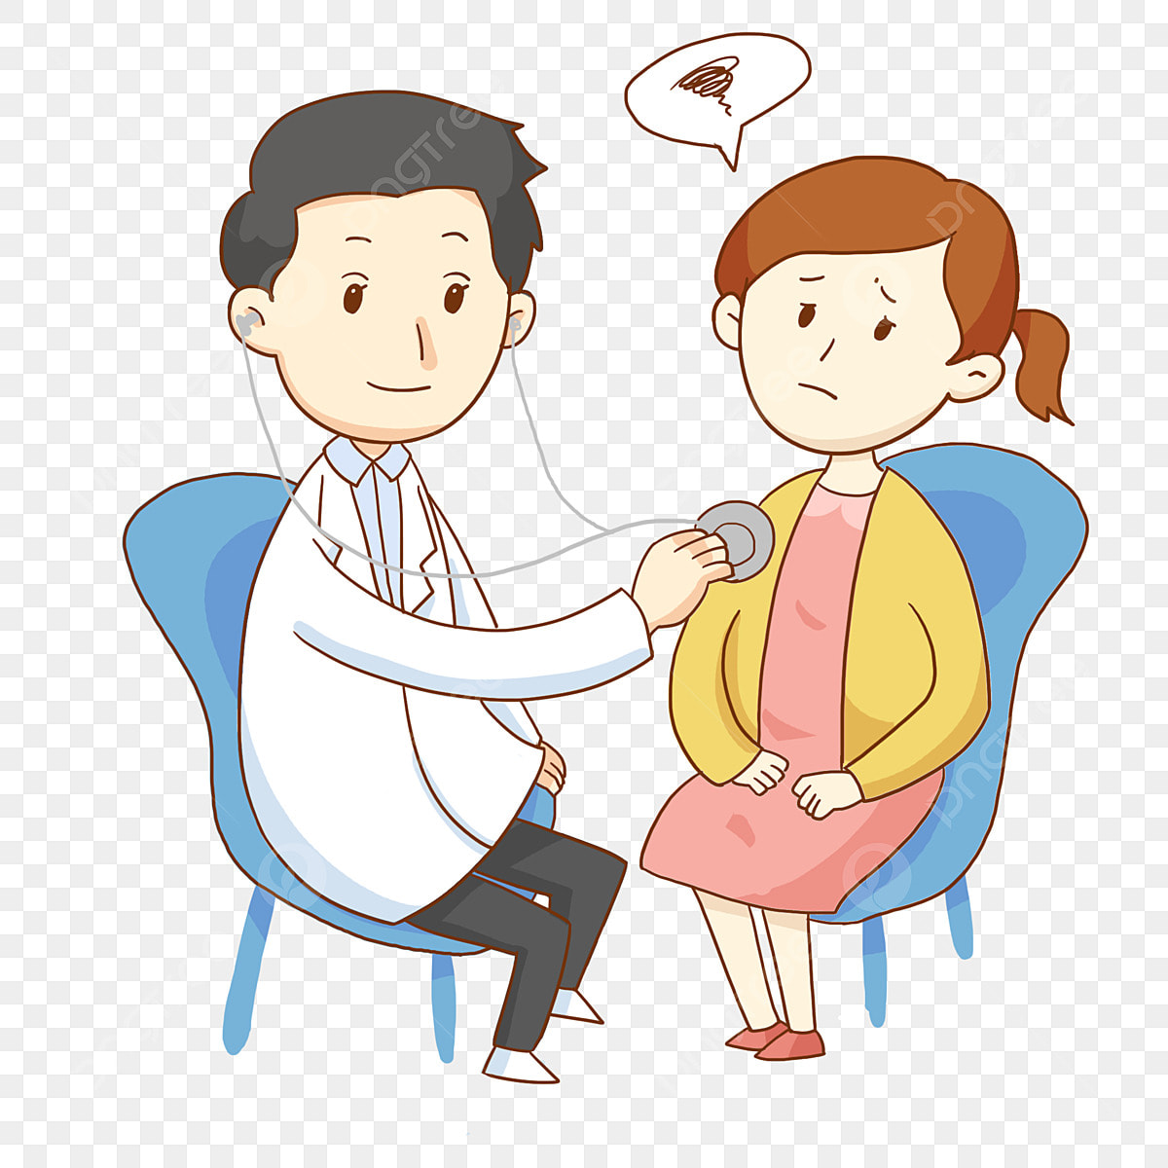
ACP Maryland chapter collaborates with Maryland Department of health to volunteer at Caroline county on May 10th from 11:00am to 3:00pm
We plan to provide information about healthy diets, vaccines, cancer screenings at various ages, blood pressure checks. Interested members can sign up with Maryellen at mew4work@aol.com by sending an email before May 1st 2025.
Disclaimer: While we give general health advice, we will not be able to diagnose or treat problems in this setting and are not a substitute for their own physician, new or refills of medications will not be provided
^{May 10th} 11:00-3:00pm
“Community health fair”

